Slide 1
Extractive Industries in the 21st Century: Challenges and Opportunities for Transformation. the cases of Lithium in Argentina and Copper in Chile.
Anabel Marín, Martín Obaya y Martín Castillo
Cenit, Buenos Aires Argentina
Notes:
This a research we are doing with Martin……funded by the Red Sur/IDRC, but related to a number of projects we have done previously on NRs and innovaiton in Latin Ameria. It is ongoing research, we are in the middle of finalising to process our info, and maninly to think and reflect on the implications of our research for future research, and policy.

Slide 2
Problem and objective of the research
Extractive industries face important challenges
There are increasing pressures for transforming these industries
Based on the theoretical framework of socio-technological transitions we analyse opportunities and challenges for transformation in two cases of extractive industries in Latin America: copper and lithium
The article is explorative in nature, seeking to experiment with the framework, to rise new issues and questions, and to open up avenues of research
Notes:
We understand that extractive indusgtries face signficant challenges, These industries are facing enourmous challengesm linked to all sort of issues, productive, technological …..they need to transform. In this research we propose to investigate how useful the theoretical framwork of transitions, recently developed by innovation schoolars to study transformations to sustainability in Europe, can be to think about this problem (
Top begin to test the framework we use two cases, copper in Chile and lithium in Argentina. The work is exploroty, ti is a first go, we do not aim to provide definitve answers, but to begin to experiment with this farmework to approach this problem, and to open up questions and ideas for future reseatrch and policy.

Slide 3
Structure of the presentation
Introduction to the theoretical framework of socio-technological transitions.
Research questions
Research design and cases
Opportunities and challenges for transforming the copper industry in Chile
Opportunities and challenges for transforming the lithium industry in Argentina
Conclusions

Slide 4
The framework of socio-technological transitions:
Conventional economics show limitations to explain change, transformations
Evolutionist authors have providing interesting analytical tools
Transition studies, start there but, interested in how to encourage transitions towards more sustainable regimes, provide new insights:
They offer a wider notion of technological ‘regime’ and ‘paradigm’
Evolutionist emphasize the importance of accumulated knowledge, existing artifacts, and firm routines in explaining change,
Transitions studies provide more importance to issues such as user relations, policy institutions, regulations, and the cultural meanings associated with a technological practice
Notes:
We are interested in changes, transformation. Conventional economics does not provide much insights about this issue, evolutionst have done. Transtions studies start from evolutionists, with the idea of paradigms, and revolutions, but more interested in understanding how to encouragetransitions to sustainability, to help transitions, they add some new insights. Opver an beyon the issues ientiie by evolutionisis to encourage change, such as the imoprtance of accumuation of knwoledge, routines, communities of practices, convergence, selection mechanisms, in explaining stability and change
Transition studies emphasise the importance, of user practices, cultural values, institutions, power, directed influences, etc.
These heterogeneous social and technical elements are understood as having co-evolved to form ‘socio-technical regimes’ that encompass both the supply and demand side of a technological system (Rip and Kemp 1998).
With this more sociological conception of technology, path dependence results not only from the constraints imposed by existing knowledge and routines, and from the increasing returns that characterize an incumbent technological practice, but also (as evolutionary economist have also noted) from the ways regulations, existing institutions and sunk investments stabilize existing socio-technical practices; from the ways in which incumbent firms and institutions have interests in the continuation of a particular technological practice, and from users’ habits and expectations about how a socio-technical practice ought to perform.
Así, cobran relevancia como factores explicativos de la transformación las estrategias y acciones de la comunidad científica, de los usuarios, de los grupos de interés y de quienes están a cargo del diseño de políticas (Geels, 2002; Geels, 2004; Geels and Kemp, 2007; Smith et al., 2005; Smith et al., 2010).
For example, the socio-technical regime of intensive commodity crop production in Latin America would be understood not only as incorporating key artefacts such as high yielding crop varieties, chemical inputs, and machines, the firms and engineers who produce and improve on those technologies, and the scientific and engineering knowledge base upon which they draw. That regime also includes the economic power and lobbying capacities of technology supply firms and commodity exporters, the institutions and policies that train agronomists and provide public and private technical support to producers, intellectual property rules, business practices for organising large scale production, the political interests and commitments that develop as a result of the foreign currency inflows and production taxes arising from exporting commodity crops, and the shifting consumption practices and expectations that create and maintain an international market for those products.

Slide 5
The framework of socio-technological transitions: a contribution to the analysis of socio-technological transformation
Compared to evolutionism, the framework put more emphasis on the role of human agency:
Transitions researchers emphasize how neither innovation or selection processes should be understood in overly deterministic ways.
Actors have and make choices about:
the kinds of knowledge and artefacts they wish to develop;
they anticipate and influence the reactions of others; and
try and modify selection environments so as to increase the chances of survival of the products of their innovative efforts.
Notes:
But what I think the main difference is betwenn evolutionists and transition schoolars, is that transition study schoolars emphasie t he importance human agency. They recognise the importance of the path dependent nature and incremental nature of change, due to knowledge, routines, inertioa etc.. But they emphasise that actors, different kinds of actors make choices, aniticipate and influnce the decisions of other, try to modify selection environments,

Slide 6
The Socio-Technological Framework: a Multi-level Perspective
Regimes constitute stable institutionally embedded configurations of technological artefacts, practices, institutions and rules
sunk costs, technological convergence and existing platforms, user practices, cognitive routines, political power, vested interests, cultural meanings
Landscape relatively exogenous social, economic, cultural and physical contexts in which both regime and niche level activities occur. They open opportunities fro change
E.g. changes in world economic conditions (e.g. decrease in the price of commodities)
Innovations develop in niches, which are experimental spaces, protected from the competitive pressures of the regime
strategic R&D, subsidies, consumers support
Notes:
Their ideas are based on the study o several cases of transformation, large scale and now morec ently also less magnficient transformations in history. Based on these studies also, they have proposed that we can understand hange looking at three levels: The regimens, or dominant and institutionalised set of practices, institutions, technologies,etc… that interacting explain stability.
The landscape, forces opearating outise the regime, including world scale phnomena such as climate change, massive advances in knowledge, drop in the proces of commodities, which often put pressure for changes to happen within the regime, and open opporutnities for change..and
Niches, that are the spaces where innovations that address the main problems of the regime are being developed. These have to protected from the selection mehanismos of the regime, so include strategic R&D projects,. Or subsidised projects by governement, or citisnsenships..
A multi-level perspective had been advocated to help make sense of, and study, the social processes involved in niche-led transition processes. This perspective comprises three nested heuristic levels: niche, regime and landscape.
Regimenes operate as retention structures, selecting results of innovation that assure stable structures They put radical innovations, disrupting innovation in disadvantavge due to here is where we see, differences with evolutionism, since they emphasise not only…
Regimes are stable in general therefore, tanto desde el punto de vista tecnológico como desde la perspectiva del equilibrio de poder entre los actores que participan de él. It happens that external forces, destabilizes, open spaces for change. Requiring changes, menores para asegurar su continuidad o, en el extremo, provocando su colapso y reemplazo por uno nuevo.
The need of change derives from issues such as migrations, world economic phenomena (for instance the decrease in the price of minerals, commodities) , environmental pressures, new social values/movements that oppose the ones dominant in the regime, chanmges in the political ideology that dominates the system, new scientific paradigms (IT, biotec). New, novel cultural …
Niches atre spaces that are partially protected from the selection pressures in prevailing socio-technical regimes and that therefore allow alternative ideas and practices that would not otherwise survive to be experimented with and improved.

Slide 7
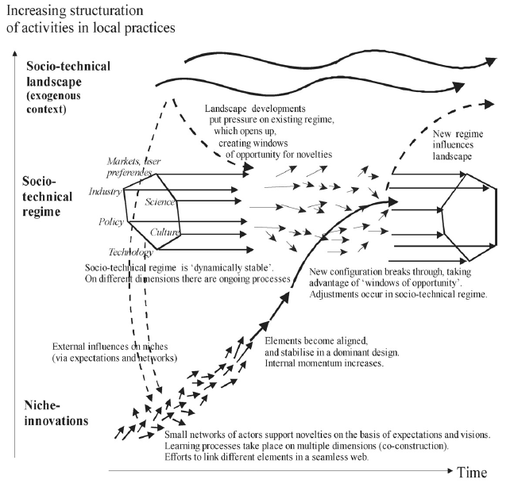
The Socio-Technological Framework: a Multi-level Perspective
Notes:
Changes emerge from interactins between these three levesl.
Niche innovations need to be nurtured and The idea it is not that the best innovations or better suited for the existing regime are selected by the markets, or existing selection mechanisms..Hjere it is emphasised that niche entrepreners fot ehri innovations to expand have to fight for them, inlfuence selection mechanisms, or create new, byt creating support, netowkrs of support, alliances, politica support, creating new cultural values, etc.. Existing regimes often will play against new things that challenge their main bases, But some times forces coming rom the ladnscape introduce trong presssures fr change. To understand possibilities ogf change then, we need to study these forces, the practices at the level of nices, to expallin change, and barriers at the level opf regimes.

Slide 8
Different types of Socio-technological Transformation Pathways
Transition pathways | Type of landscape pressures | Level of maturity of niches | Dynamic and results
Weak transformation | Moderate pressures | Underveloped niches | Strong and adaptive regime “imports” nondisruptive innovativons to guarantee its own survival. Regime actors survive. E.g. transition from the septic tank system to the sewer system in the Netherlands in the nineteenth century; organic food movement.
Reconfiguraton | Strong and abrupt pressures for change | Several symbiotic niche developments with strong potential to address regime problems | Regime is robust but adaptive. Progressive incorporation of niche innovations lead to a significant reconfiguration of the regime. E.g transition from traditional plants to mass production in the United States.
Technological substitution | Strong pressures | Niches are well developed. However, they are not able to reach the regime, as this remains stable and consolidated | Landscape pressures open up possibilities for niche initiatives to reach the regime. Regime actors defend themselves. If niche innovations manage to succeed, the regime undergo substantial changes and its main actors are replaced. E.g: transition from sailing ships to steam ships.
De-alignment and re-alignment | Strong pressures | Multiple niche initiatives at embryonic levels compete for resources | Landscape pressure erode and cause the colapse of the regime. Main actors “lose faith” in it. Destabilization creates uncertainty about the new rules. Niches compete for resources and social support until one of them emerges as the new dominant regime. Historical examples: transition from horse carriages to cars.
Notes:
Depending hot these three are and their interactions, some authors have identified different types of teresting idea emergin from these studies is that so, with different types of regimes, pressures for change and niches, we will have different types of transformations. Based on hotyorical studies, for instance, Geels and Schot identified four types…

Slide 9
Research Questions
On the nature of landscape pressures for transformation
Where do they originate? Are they strong? What kind of change do they favour: moderate, abrupt?
On regimes
How do they deal with pressures? Are they flexible to change? Do they have the capacity to deal with challenges and pressures for transformation?
On niches
What types of niches have been developed? How advanced are the initiatives within them? What actions have been taken to protect them from regime selection mechanisms? What is they nature in relation to regimes: symbiotic or disruptive?
How do the three levels interact among them?
JUST A EXPLOROTARY STUDY
Notes:
With this framework in mind and with the idea of contributing to understand possibilities of trasformation of extractive industries we propose then to explore the following questions.
trabajo proponemos explorar las siguientes preguntas.
La naturaleza y alcance de las presiones para el cambio:
Donde se originan?
Son estas moderadas o fuertes?
Favorecen el cambio o son meramente disruptivas?
La existencia de nichos que estén explorando soluciones innovativas para abordar los desafíos que enfrentan las industrias:
quienes son los emprendedores de estos nichos?,
cuan avanzados están los proyectos en los nichos?
El ascenso de las innovaciones desde el nicho al nivel superior de régimen, sin embargo, no es automático. Por el contrario, como se discutirá más adelante, requiere un trabajo activo de consolidación (nurturing) y de fortalecimiento (empowerment).
Niche actors, are seen as actively constructing protection for their novel practices, developing and nurturing them, influencing regime selection environments, and representing their novel practices as solutions to landscape-generated problems that affect regime activities.
que tipos de acciones están siendo llevadas adelante para expandirlos/ fortalecerlos y quienes están llevando adelante estas acciones?
Son estos nichos disruptivos o simbióticos?
El nivel de stress bajo el cual están los regímenes actuales, cuanto están siendo cuestionados y presionados para el cambio en las condiciones actuales, cuál es su reacción y capacidad de adaptación?
En este trabajo no pretendemos dar respuesta a todas estas preguntas. Mas bien, en base a la evidencia de los casos que fue posible recolectar en el trabajo de campo intentamos empezar a reflexionar sobre la importancia de las preguntas derivadas del marco de transiciones para investigar este fenómeno, identificar casos relevantes que sirvan para utilizar el marco e identificar nuevas preguntas y problemas para seguir investigando.

Slide 10
Research design
Case studies: good for new, under-researched phenomena and to explore “how” and “why” questions.
Theoretically-driven selection of cases.
The two selected cases are facing significative challenges and are currently engaged in transformation
However, they are very different:
Lithium in Argentina, a small but emergent sector
Copper in Chile, a long-established and mature industry with strong weight on the domestic economy
Notes:
We use case study methodology
In depth or case study methodology is useful to understand dynamics present within single settings. It is good for providing rich descriptions of new poorly understood phenomena, to explore how and why questions about pre-identified new phenomena, issues, ideas, etc.
A key aspect of this kind of design is the selection of cases, which have to be representative of the phenomenon we are interested in.
Our sample therefore is not representative, randomly drawn from a population; it is rather theoretical or purposive. We identified exemplary (not typical) decisive cases theoretically defined.
Based on these interviews and a number conducted with key informants from the public sector, universities and consultancies, we select the most innovative local suppliers in each context. We did not exclude of the sample of firms studied small firms, or new entrants, or suppliers that were strictly private. The idea was to select both settled and new firms with high potential of growth which have developed innovative solutions to mining problems in the three countries.
Nos centramos en los casos del cobre y litio en Argentina and Chile, respectivamente, para reflexionar sobre las posibilidades de transformación. El análisis de estos casos ofrece la oportunidad de comparar regímenes de características muy distintas, en lo que respecta, por ejemplo, el tiempo de maduración de la trayectoria del sector en cada país, la dimensión del mercado, la conexión con otros sectores aguas arriba y aguas abajo, etc. En este sentido, aun cuando hay empresas que operan en el sector desde hace décadas, podría concebirse el litio un régimen en estado emergente y con cierto grado de inestabilidad –en particular en Argentina. El del cobre, por el contrario, es un régimen maduro, con actores consolidados y una importancia central para la economía de Chile, que enfrenta desafíos propios de este estadio avanzado.

Slide 11
Research design
Data collection was based on literature and semi-structured interviews with key informants in each sector from:
Mining companies, producers and suppliers
Researchers from the scientific system
Policy makers
Consultants
Civil society (still to do some more)
Notes:
La recolección de información se basa en fuentes secundarias y en entrevistas semi-estructuradas con informantes clave, según se detalla en la Tabla 2.

Slide 12
The case of copper: The regime
Regimen long-stablished
Very powerful and important within the country
Chile main copper producer, 30% of world market,
Copper explains 8% of GDP, 16% of fiscal incomes, 50% exports
Dominated by a small number of large actors, mostly transnational, BUT CODELCO
With strong presence of state, market driven perspective,
Recently expanded, gained importance
But questioned, with strong pressures for change

Slide 13
The case of copper: pressures for change
Two types of pressures:
From pressures within the regime: productive, technological
Increasing costs, drop in productivity, problems to access key inputs
From outside: of development
Need to augment local linkages, incentive local technological capabilities, reduce negative environmental impact and reduce social conflicts

Slide 14
The case of copper: Reaction of the regime
Aware of the need for change
Trying to developing articulated responses, through public and private partnerships
La Alianza Valor Minero
Programa Nacional de Minería Alta Ley
Programa de proveedores de clase mundial
But not very strong commitments from private companies or public sector
Reduced investments
Several responses in course, but all very incipient

Slide 15
The case of copper: Niches (EXAMPLES)
Responding to productive and technological challenges
Subterraneous mining:
Initiative: Public company, Codelco
World class innovation, the largest mining project developing this technology in the world
Human capital:
Training human resources of excellence (the idea is to take researcher from 350 to 600)
Match supply and demand of skills
Notes:
programa “Capital humano” que busca aumentar de 350 a 600 el número de investigadores de excelencia en la industria minera para el 2035. Con financiamiento de la Comisión Nacional de Investigación Científica y Tecnológica (CONICYT), el programa es un concurso para asignar becas para realizar estudios de doctorado y postdoctorado en el exterior. La segunda iniciativa, que continúa los esfuerzos del Consejo de Competencia Mineras en la promoción y mejora de la formación de técnicos y profesionales del sector minero, busca generar información pública para adecuar el perfil de la oferta laboral a las necesidades de la industria. Esta iniciativa tiene financiamiento del Consejo Minero y cuenta con la asesoría de Innovum Fundación Chile.

Slide 16
The case of copper: Niches (EXAMPLES)
Responding to developmental challenges:
Programme World Class Suppliers
Initiative of BHP, then Coodelco and others
To match demands of mining companies, with local capabilities
Reached 600 out 3000 suppliers
Developing testing spaces
Tailing tanks
Limited responses to social problems, dialogue

Slide 17
The case of copper: Possibilities of transformation
Regimen under considerable stress due to maturity, responding, adaptative
Consensus within the regime and niches are very incipient, need to to get
More commitment from private companies, abandon short term bias in vestment decisions (e.g. problems PWCS, Marin, Olivary, Pietrobelli, 2016)
Continuity of policy support
Take care of institutional problems, e.g. IPR
But all responses are from inside, niches are very symbiotic,
Not path breaking niches that address sustainability challenges

Slide 18
The case of lithium: The regime
Emergent
Potentially, in the next few years, Argentina may become the larger producer of lithium in the world
Growing importance, but still insignificant weight in the domestic economic structure
Dominated by a small number of large transnational companies
Extractive-oriented approach
Normative framework set rules favouring extractive activities
ExceptionJujuy (development-oriented policy approach)
Local communities involved

Slide 19
The case of lithium: pressures for change
Two types:
Productive/technological: pressures from within the regime:
Local specificities: need to adapt technology to local environment.
Developmental: landscape pressures:
The “curse” of mining industry. Pressures for increasing linkages with the socio-economic fabric
Environmental pressures: the problem of water
Social tensions with local communities. Social license.
Notes:
Inefficient technologies based on evaporation
Underexploited resources: production activities based on potassium and lithium chloride. Other resources in brines: magnesium, calcium, borates, sulfates, carbonates, rubidium and cesium.
Lack of knowledge of local geology: geometry and brines dynamics

Slide 20
The case of lithium: Reaction of the regime
Limited due to the peripheral, disarticulated, character of the regime dominated by transnational subsidiaries specialised in extractive activities, with little linkages with strong local actors
Domestic subsidiaries, dominating actors, with limited capabilities, rely on headquarters
Public institutions and local actors starting to develop initiatives, with little resources and sustained support
E.g. province of Jujuy. Lithium as a “strategic natural resource”.
JEMSE
Industrial park for mining and logistic services

Slide 21
The case of lithium: Niches
Niche | Challenges | Actores clave |  | Iniciativas
Upstream niches: Productive and technological issues | Geology and chemical composition of the brines Extraction and production processes Resources exploitation Environmental issues | INQUIMAE CONICET Universidad Nacional de Jujuy | Transnational extractive companies | Creación del Centro de Investigaciones Científicas y Tecnológicas sobre el Litio (CONICET) | Research projects to improve knowledge on the geology and dynamics of brines (UNJU-CONICET)
Downstream niches: development | Weak linkages and low added value Extractive model Production of lithium-ion battery Production of nuclear fusión energy |  | FAMAF INIFTA Y-Tec CNEA |  | Basic and applied research on bateries: Catching-up initiatives: lithium-ion Frontier initiatives: lithium-air Research on lithium as a fuel for nuclear fusion

Slide 22
The case of lithium: upstream niches
Addressing the productive and technological challenges:
Scientific and technological community (niches):
Extracting processes
Geological studies
Research projects to improve knowledge on the geology and dynamics of brines (UNJU-CONICET)
Notes:
The literature in general identifies two…, we identify a third type of niche.. Not very clear if will contribute to expand the reguime, or questioned it at the end, by gaining importance

Slide 23
The case of lithium: downstream niches
Addressing the socio-development pressures.
Batteries:
Lithium-ion batteries: FAMAF (UNC) / INIFTA (UNLP) / Y-TEC
Tablets, computers
Energy storage
Vehicles
Lithium-air batteries: INQUIMAE (UBA)
Energy for nuclear fusion:
UNJU, CNEA
Role of Lithium Institute (CONICET)
Limited responses to environmental and social problems, corporate responsibility
Notes:
The literature in general identifies two…, we identify a third type of niche.. Not very clear if will contribute to expand the reguime, or questioned it at the end, by gaining importance

Slide 24
The case of lithium: Niches – Level of Development and Challenges. Possibilities of transformation
Regimen under stress for change, due to the emergent character, less acute than copper
Responses coming from actors coming from outside the nucleus of the regime,
Incipient niches, very dependent on public policies, fine, but
Weak development of public tools (e.g. delay and budget cuts in Lithium Institute).
Need to get support and align public/private actors (e.g. to commercialise batteries)
Need to develop a strategic vision at government level (isolated initiatives, e.g. law projects).
E.g. batteries, normative frame does not provide location advantages
A new type of niche??
Notes:
Downstream niche:
Normative frame does not provide “location advantages” for downstream niches. Initiatives are based on “symbolic” and “strategic” visions pushed by socio-economic pressures.
Commercialisation constrains (hierarchical value chains, e.g. vehicles)

Slide 25
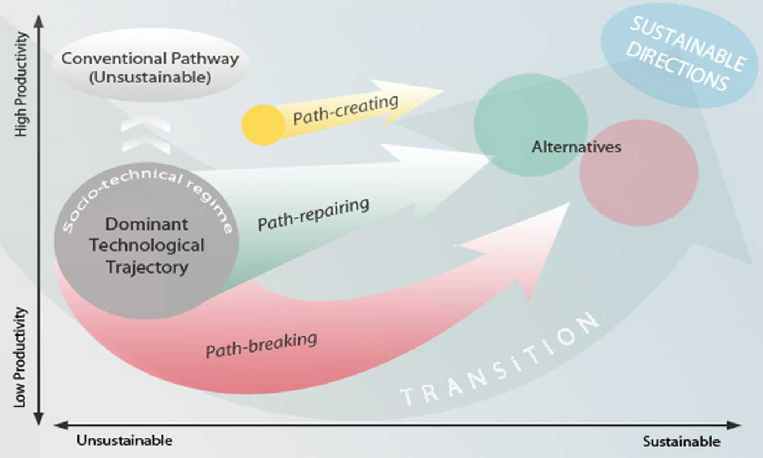
SUMMARY, preliminary conclusions from the two cases: Different types of niches
Types of transformations, types of niches
Notes:
Historical studies have identified different type sof transformations and niches, two broad are: In some circumstances, niche practices may become competitive in (changing) selection environments and translate into more mainstream business models and markets, gradually displace regime activities which are unable to manage technical, environmental or social weaknesses with incumbent practices. In others niche ideas demonstrate alternative ways of providing goods and services and some of these get appropriated into an adapting regime (Smith, 2007) In many circumstances niche activities never develop beyond small scale or experimental, prototype activities.

Slide 26
Conclusions
The two regimes under considerable pressures for change and transformation from pressures that challenge the sustainability of the activities in the medium term (more copper)
The topic is very important!
The framework potentially important to help to understand the phenomena
The two regimes are reacting differently due to differences across:
History and characteristics of the regimes
Type of pressures that are receiving
Type of niches being developed
Different types of transformations possible?

Slide 27
Dimensions for change | Copper | Lithium
Forces inducing change | Strong, important, linked to maturity Coming from within and out the regime | Medium, linked to emergent character Coming from within and out the regime
Type of regime | Consolidated, adaptive, semi-periferic, semi transnational | Emergent, unstable, transational/periferic
Reaction of the regime | Private/public consensus High number of initiatives, real commitment not so clear | Limited, chaotic Lack of articulation and consensus between actors
Type of niches, level of development | Incipient/untested, symbiotic, path-repairing, not path-breaking | Incipient, path-repairing, path creating, symbiotic (not path breaking)
Protection | Medium, deriving from companies, public and private Need to develop more commitment by private | Medium, deriving from public funds Unstable commitment
Interactions regime/niches | High, harmonic | Disarticulated, chaotic isolated responses
TYPE OF TRANSFORMATION | RECONFIGURATION OR WEAK TRANSFORMATION?? | WEAK or RADICAL TRANSFORMATION?

Slide 28
Conclusions
Areas of future research
We need to investigate more deeply and carefully:
Responses of the regime and limitations to respond
The niches, identify more
Their nurturing and empowerment strategies, to affect the regime and transform it in any of the possible directions
Network development, resources and support capture,
Barriers to expand (capabilities, vested interests, power..)
The possibilities of less symbiotic niches, with higher capacity of divergent solutions, and transform
Interactions, niches regimen: limitations imposed by regimes to niches,
Need to reflect on the nature of changes required to address the main challenges.
Would incremental changes, encouraged by dominant actors within existing regimes be enough? or
Do we require radical changes?

Slide 29
Conclusions: Challenges for innovation and technology policy
Challenges for innovation and technology policy
Need to adopt new approaches, be ahead of the need to transformations
Introduce pressures for change and create opportunities for change
Supporting niches, that experiment with new and different kinds of ideas. The question is
Incremental, or radical?

Slide 30
Conclusions
Contributions for social, economic and/or environmental sustainability of extractive industries.
Need to support projects that address social and environmental problems
But approaching them as niches, with possibilities to develop innovations that can contribute to improve or change the regime
Not social and corporate responsibility
No social policy
Main lessons for LAC.
Nee to develop tools, policies that address the character perierica an transation o the regimes

