Slide 1


Chilean Mining Challenges
Innovation and Sustainability in the Chilean Mining Industry
Francisco Klima
Francisco.klima@fch.cl
Septembre 21st

Slide 2
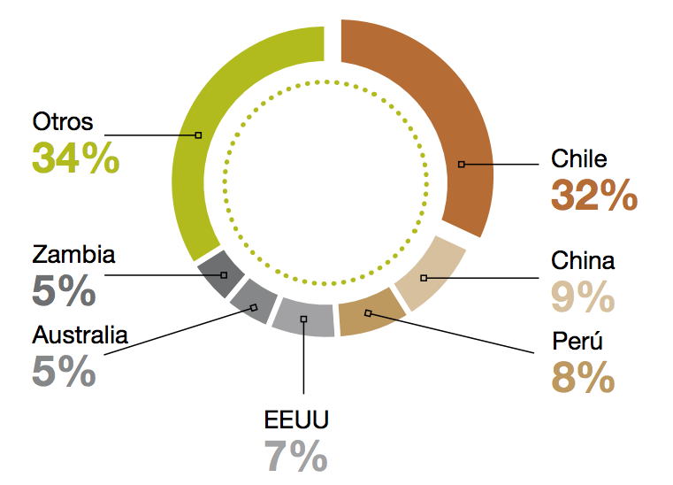
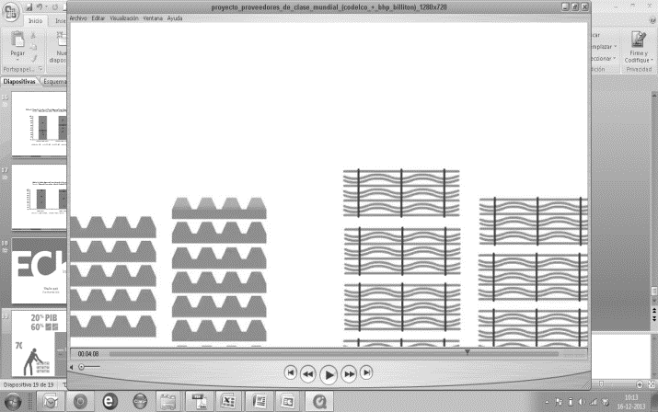
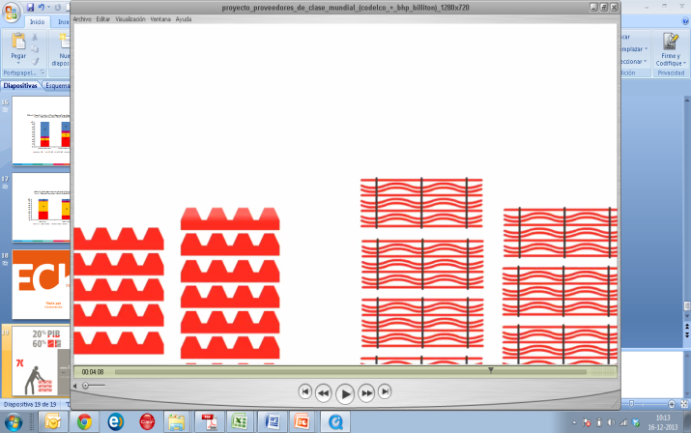

National Impact of Copper
World Copper Production Participation
12 %
GDP
Chile represents
1/3 of reserves
1/3 of sales
14,8 %
Others
FISCAL REVENUE
60 %
USA
Fuente: Consejo Minero Reporte 2012-2013
EXPORTS
13 %
15 companies: 95% of copper´s national production
WORKFORCE

Slide 3
National Impact of Copper
The national impact of copper production has increased considerably over the last two decades, influencing the design of public policies and the country's macroeconomic stability.
Certain fundamental questions arise when this is taken into account:
  Will copper continue to be the engine of the Chilean economy?
  How long can it continue playing that role?
  Does the leap to development depend on this mineral?
Can copper assume a new role in the country's development and contribute to the generation of technological innovation and productive diversification?

Slide 4
The future of mining is today’s task
KICK-OFF PRODUCTIVITY, INNOVATION & GROWTH AGENDA
CHILE’S MINING & SUSTAINABLE DEV. REPORT: TOWARDS A SHARED VISION
MINING AGENDA KICK-OFF: A PLATFORM FOR CHILE’S FUTURE
LAUNCH NATIONAL AND REGIONAL MINING STRATEGIC PROGRAMS
CHILE’S MINING INDUSTRY ROADMAP (2015-2035)
MAY
2014
JUNE
2014
DECEMBER2014
JANUARY
2015
DECEMBER
2015

Slide 5
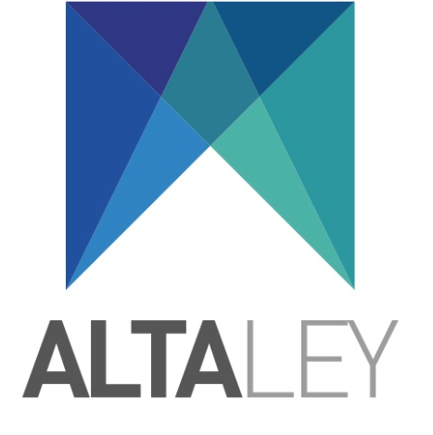
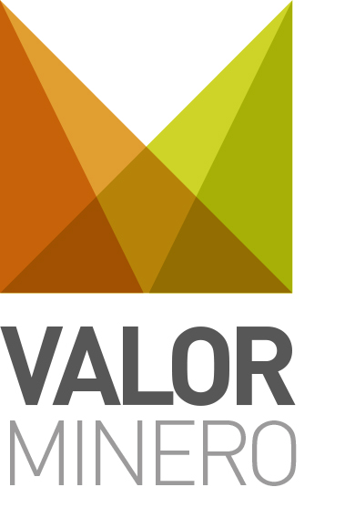
An Inclusive and Inspiring Vision
VIRTUOUS MINING, by strengthening competitiveness and productivity it generates conditions that enable the emergence of a robust innovation ecosystem fostering and accelerating a knowledge economy.
SUSTAINABLE MINING, incorporates design into all critical operation variables affecting the social-environmental system.
INCLUSIVE MINING, favors the participation of communities on generated benefits.

Slide 6
Long-term Scenarios
Scenario A
Fully Leveraged Mining Potential
Scenario B
Wasted Mining Potential
BASE/Operations
BASE/Projects
PROBABLE/Projects
POSSIBLE
POTENTIAL/ Cu Project
SOURCE: FCH (BASED IN COCHILCO’S DATA)
SOURCE: FCH (BASED IN COCHILCO’S DATA)
SOURCE: FCH (BASED IN COCHILCO’S DATA)
SOURCE: FCH (BASED IN COCHILCO’S DATA)

Slide 7
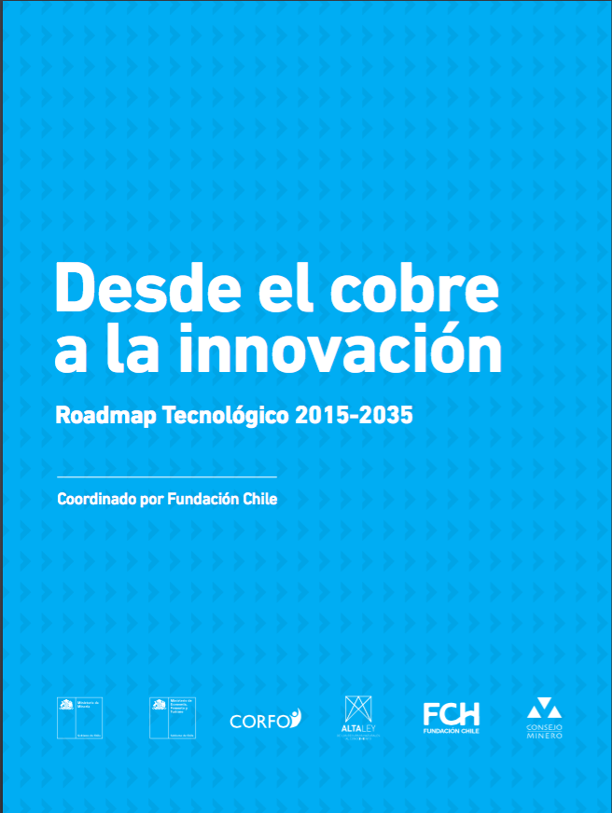
From Copper to Innovation
Technology Roadmap 2015-2035
The essential premise of a road map is that the future can be built, in contrast to a passive attitude in which the future simply happens.
The initial stage before drafting a road map consists on reaching a consensus on a vision for the future and specifying the objectives and dilemmas of a given sector, in this case mining, over a 20-year period.

Slide 8


ROADMAP

Slide 9


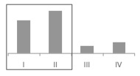
Purpose & Impact
Average production per year last 10 years of 5.5 million metric tons of copper
Export 130 to 150 millon Cu tons and other minerals
Develop a services and goods industry based on applied science and technology that addresses productivity challenges in the mining sector through the creation of a robust collaborative innovation ecosystem with industry, suppliers, scientific & research community—academia and State.
250 world class suppliers
65 world class suppliers
US$ 4 b in goods and services exports
US$ 537 m in goods and services exports
80% of production at first global cost industry quartiles
40% of production at first global cost industry quartiles

Slide 10
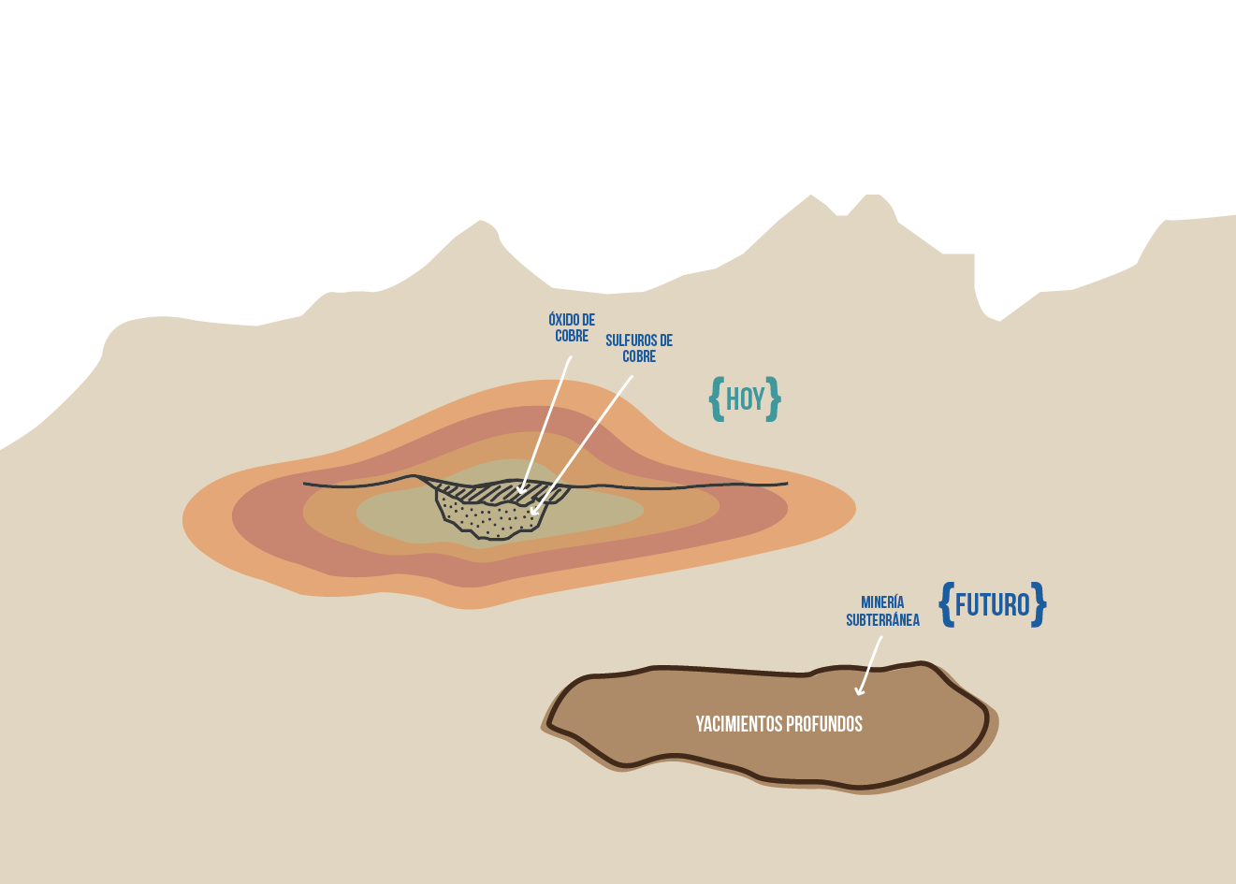
Current Scenario and Future Challenges for the Mining Industry
While Chile's potential for mining production remains intact, the conditions that make the development of this industry possible have changed.
Costs have increased, productivity has declined and environmental and social sustainability have become imperatives in its development.
Deteriorating quality of geological resources, specifically declining copper ore grades at existing mines, has created a scenario in which mining firms must make major efforts to maintain their production levels.
The long transportation distances caused by the deepening of mines, increased movement of materials thanks to deteriorating resource qualities and more complex processing due to greater rock hardness and the presence of contaminants, have all been translated into important factors that reduce productivity.

Slide 11
Growing Water and Energy Demand
Increase in electricity demand from 23TWH to 40TWH
High impact of energy on industry costs: aprox. 20%
Increase of water consumption (fresh and seawater) of 66% (14,8 m3/s to 24,6m3/s) due decreasing grade of concentrate
Use of seawater could increase over 40% of costs associated to energy
PROJECTED ENERGY CONSUMPTION
(TWH)
PROJECTED WATER CONSUMPTION
(m3/s)
40 TWH
24,6 m3/s
BASE
PROBABLE
POSSIBLE
FRESH WATER
SEAWATER
SOURCE: FCH (BASED IN COCHILCO’S DATA)
Fresh water

Slide 12
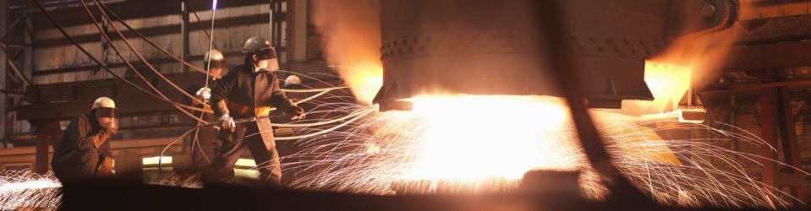
Mining as Source for Innovation
Challenges faced by the mining sector require innovation + R&D; if not addressed global market share will be lost.
Given the complexity of the current situation, isolated R&D and innovation initiatives are not enough. They require a collaborative effort by all sector agents (mining companies, suppliers, R&D centers, trade associations, etc.).
Natural resources, particularly mining, offer a unique opportunity to develop local knowledge (biotechnology, information and communication technology, automatization and process control, etc.).
How to leverage the opportunity?

Slide 13
Strategic Priorities
1
UNDERGROUND MINING: DEVELOPMENT OF LARGE-SCALE DEEP MINING
2
IMPROVING COMPETITIVENESS OF SMELTING AND REFINING
Based on the challenges identified in the process of drafting the Road Map, eight strategic priorities were identified for dealing with the problems noted
3
MINE TAILINGS DEALING WITH INCREASED SCARCITY OF SPACE AND MINIMIZE THEIR IMPACT
4
IMPROVING PRODUCTIVITY OF OPEN-PIT MINES MOVING LARGE VOLUMES OF EARTH LARGE DISTANCES
5
STRENGTHENING THE DEVELOPMENT OF LOCAL KNOWLEDGE AND TECHNOLOGY INTENSIVE SUPPLIERS
6
STRENGTHEN EXPLORATION ACTIVITIES IN CHILE
7
ENABLING THE DEVELOPMENT OF SMART MINING
8
DEVELOPMENT OF HUMAN CAPITAL IN LINE WITH THE INDUSTRY’S CURRENT AND FUTURE NEEDS

Slide 14
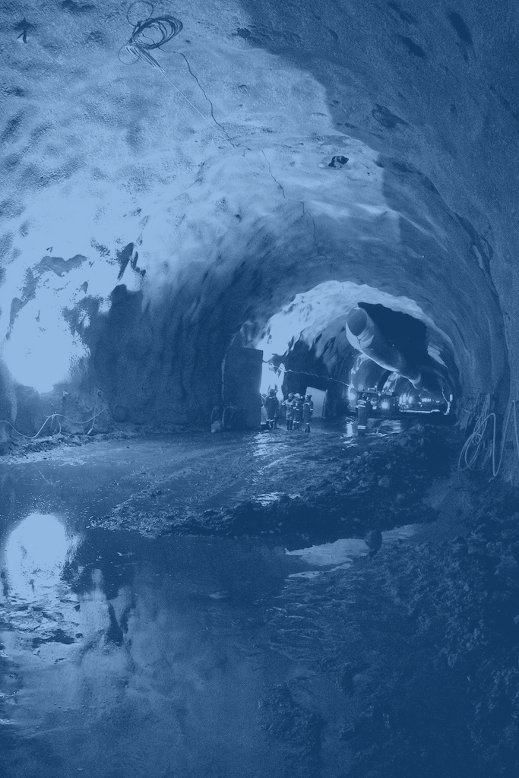
1
Building, managing and operating large-scale underground mining projects poses an unprecedented challenge to the global mining industry, due to its complexity as well as the production volumes associated with it.
The possibilities associated with mechanization, automation, remote operation and robotization will help to make the transition to continuous underground mining that is safer (zero accidents), more productive and has lower production costs.
UNDERGROUND MINING: DEVELOPMENT OF LARGE-SCALE DEEP MINING

Slide 15
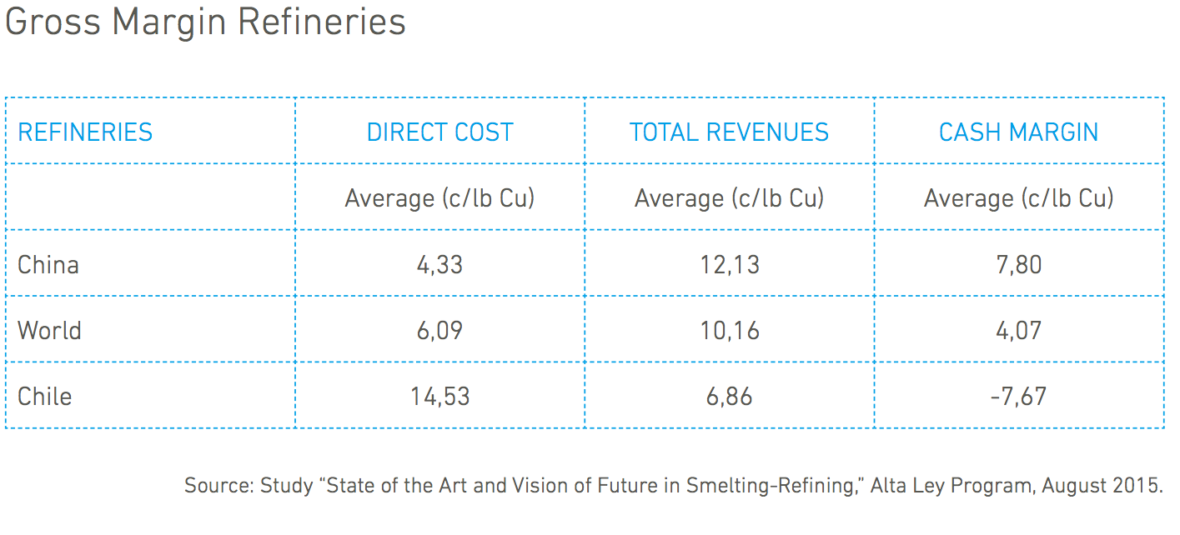
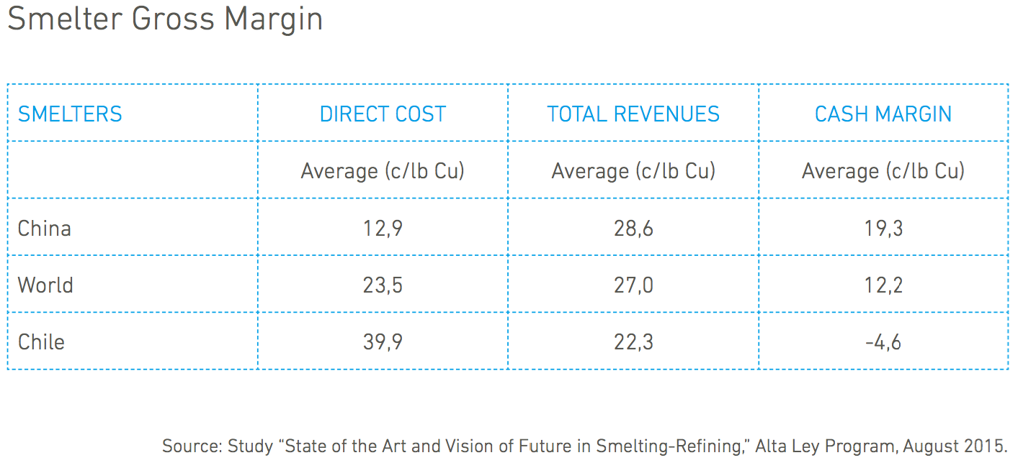
IMPROVING COMPETITIVENESS OF SMELTING AND REFINING
There are currently seven copper smelters in Chile: five are state owned (Caletones, Potrerillos, Hernán Videla Lira, Chuquicamata and Ventanas) and two are private (Chagres and Altonorte).
Smelters’ performance can be evaluated as a function of direct operating costs, revenues and the level of capture and sequestering of metallurgical gases. Chilean smelters are in an unfavorable position with regard to other global actors in all of these categories, which is explained by low revenues and high labor and energy costs. Low levels of metallurgical recovery also have an impact, as they reduce Bonus Metal revenues.
Chilean refineries in an uncompetitive position: in 2013 they were in the last decile of the industry in terms of gross margin, which registered negative numbers. This is because their costs are higher than those of the rest of the industry (Amec Foster Wheeler, 2015).

Slide 16
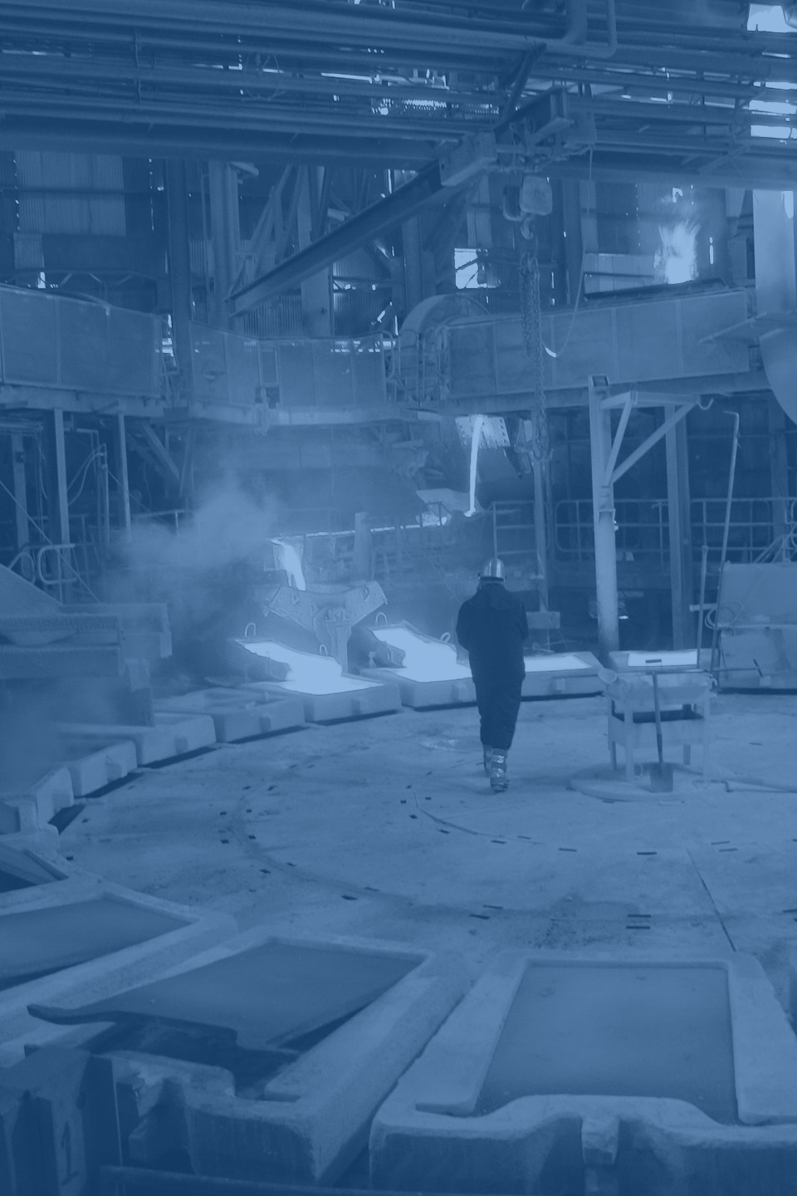
2
Chilean smelters are at a disadvantage compared to other global actors, which is explained by low revenues, high costs (labor and energy) and low metallurgical recovery rates, and the obsolete technologies they operate with.
IMPROVING COMPETITIVENESS OF SMELTING AND REFINING
Challenge No. 1: Increasing efficiency.
Challenge No. 2: Reducing the environmental impact.
Challenge No. 3: Improving labor conditions.

Slide 17
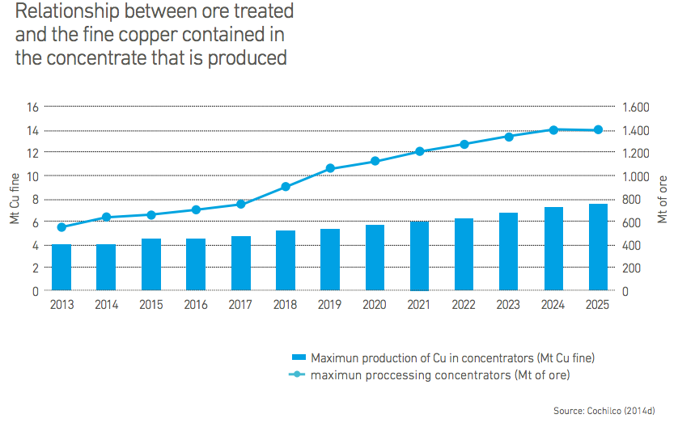
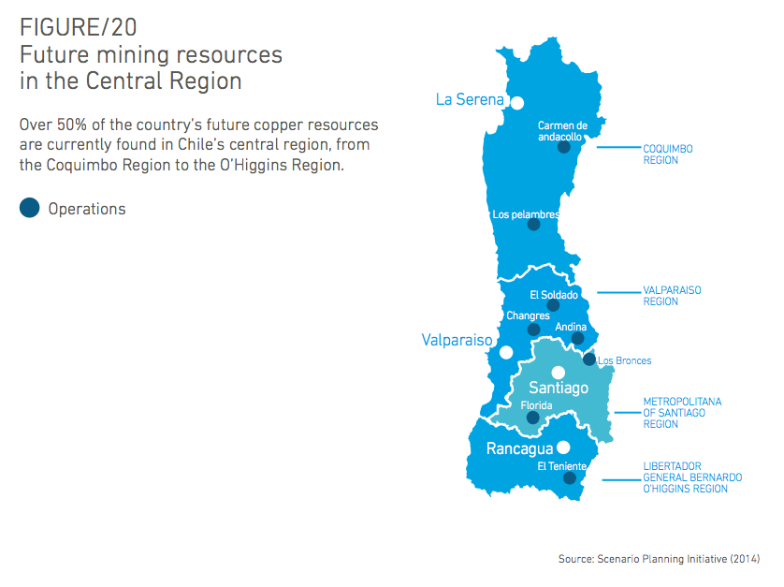
MINE TAILINGS DEALING WITH INCREASED SCARCITY OF SPACE AND MINIMIZE THEIR IMPACT
The 5.7% annual increase in fine copper contained in concentrates means that treatment of the ore must grow at a rate of 8% annually, increasing from 549 million tons of ore treated in 2013 to 1.389 billion tons in 2025.
Tailings are currently a major source of conflict between companies and communities: 47% of the tailings produced in the country have complaints against them or some sort of conflict with the population.
The increasing scarcity of water and space must be considered, critical matters when the projected increase in tailings is considered. In fact, in the future a significant proportion of mining production will take place in the central region, where the population density is higher and where there is more competition over the use of land and water resources.

Slide 18
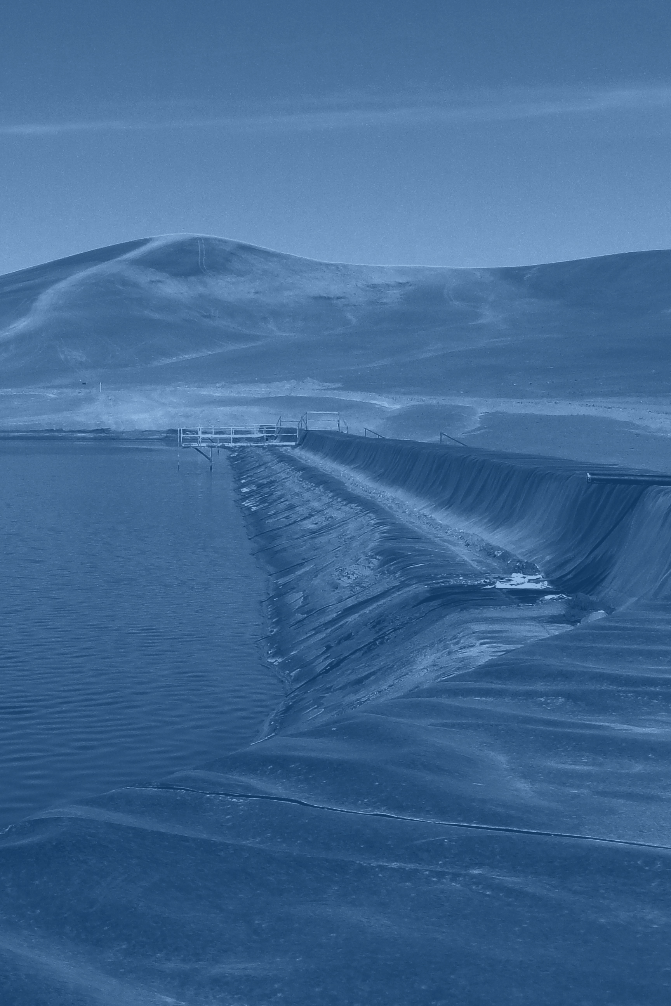
3
The mining industry must remove increasing quantities of material to extract copper and other valuable elements, mostly - and increasingly - through flotation and concentration. This has significantly increased the volume of waste that must be disposed of, either in the form of sterile material or as tailings, and it will continue to do so in the future.
MINE TAILINGS DEALING WITH INCREASED SCARCITY OF SPACE AND MINIMIZE THEIR IMPACT
Challenge No. 1: Dealing with increasing shortages in water and space.
Challenge No. 2: Minimizing the impact of leakage and ensuring the stability of dumps.
Challenge No. 3: Promote conversion of a liability into an asset
Challenge No. 4: Fostering community inclusion and acceptance

Slide 19

Chile’s aging mines and their increasing depth has led to increased rock hardness, transportation distances, and declining average ore grades. the need to move more waste material and to grind a larger volume of increasingly harder rock has a direct impact on energy consumption and consequently increases costs and reduces productivity.
4
IMPROVING PRODUCTIVITY OF OPEN-PIT MINES MOVING LARGE VOLUMES OF EARTH LARGE DISTANCES
Challenge No. 1: Increase productivity
Challenge No. 2: Increased mineral resources and reserves
Challenge No. 3: Environmental protection and social responsibility
Challenge No. 4: Greater workplace safety and quality

Slide 20
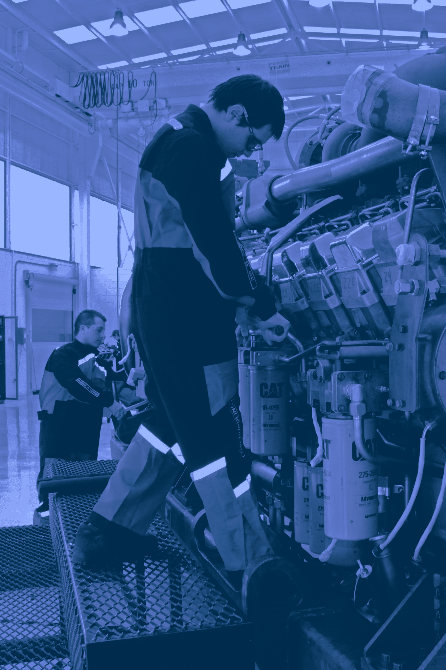
5
The national mining industry is in a transition to a new stage, one in which the inclusion of knowledge, innovation and technological development become sources of significant competitive advantages.
In this context, the consolidation of a sector of suppliers, METS (mining equipment, technologies and Services), is an enabling factor for the future development of the chilean mining sector and at the same time it offers a unique opportunity of technological development, diversification and increased sophistication of products and development of an export portfolio of services, technologies and equipment for the global mining industry.
STRENGTHENING THE DEVELOPMENT OF LOCAL KNOWLEDGE AND TECHNOLOGY INTENSIVE SUPPLIERS

Slide 21
STRENGTHENING THE DEVELOPMENT OF LOCAL KNOWLEDGE AND TECHNOLOGY INTENSIVE SUPPLIERS
21.237
22.019
5.000 supliers aprox.
Highly concentrated market
Barriers that have prevented the Chilean suppliers sector to deploy its full potential.
17.924
18.084

Slide 22
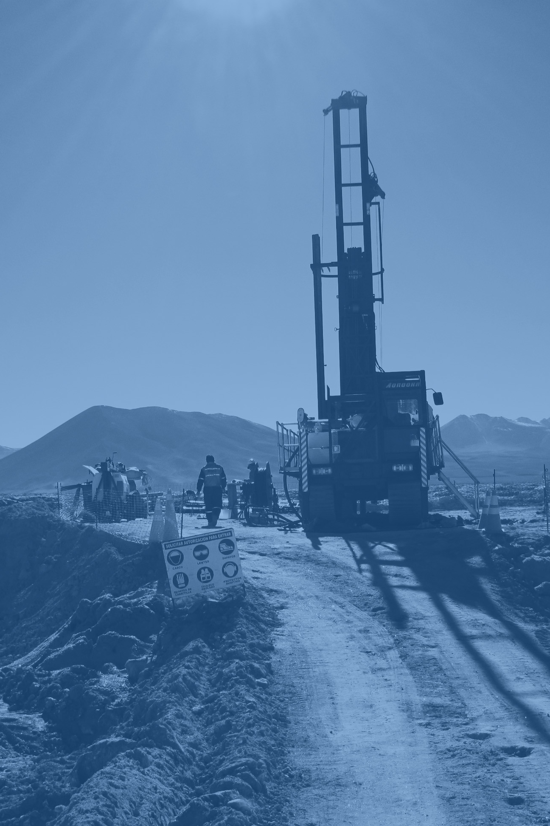
Chile currently possesses 29% of known copper reserves and has accumulated knowledge and expertise in their exploration and extraction.
The prevailing trend and future projections privilege investment in existing projects, or brownfield investments, thus explaining the remarkable decline in ore grades.
Exploring deposits other than those which currently exist and strengthening investments in greenfield projects is fundamental to improving the quality of resources.
6
STRENGTHEN EXPLORATION ACTIVITIES IN CHILE
23% of the concessions show some degree of exploitation
Basic geological informatios
Instruments to promote exploration

Slide 23
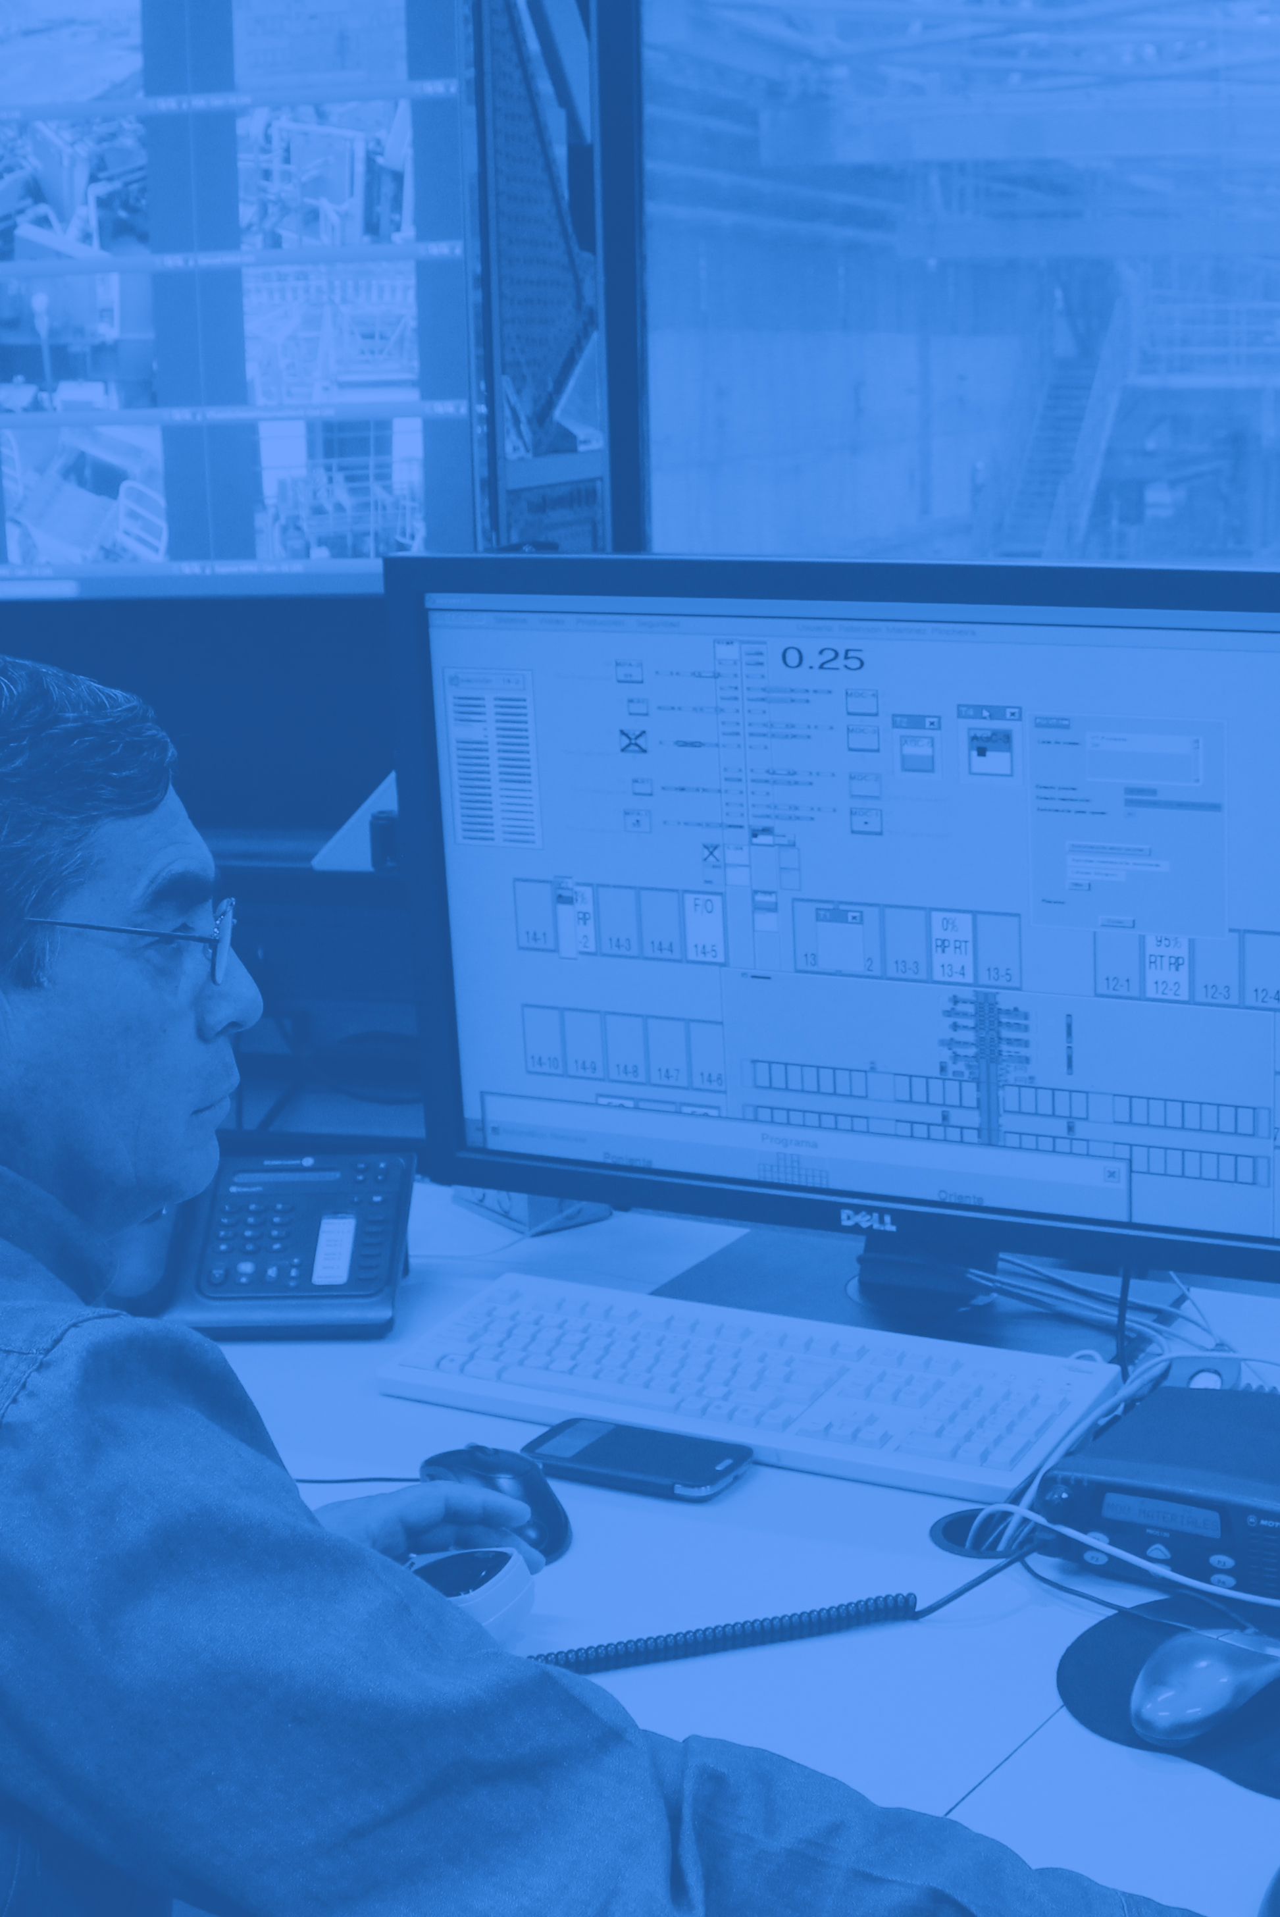
7
Adoption of intelligent technologies would allow the mining industry to improve its productivity through better planning and coordination of its activities.
This would mitigate potential sources of uncertainty and reduce the variability that is inherent in mining operations.
Determination of standards and protocols for interoperability, understood as information and communication technology systems’ ability to exchange data and allow information and knowledge to be shared, is a feature that will enable the development of smart mining.
ENABLING THE DEVELOPMENT OF SMART MINING

Slide 24
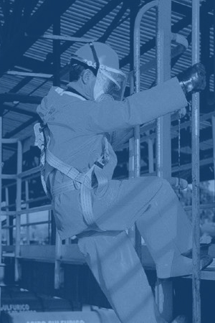
Making progress toward an innovative mining sector depends to a great degree on the quantity and quality of the human capital available.
The mining industry’s operating conditions have become more and more demanding and the materialization of future projects will, among other things, require new technologies and aligning the quality of training that human capital receives with the industry’s new needs.
8
DEVELOPMENT OF HUMAN CAPITAL IN LINE WITH THE INDUSTRY’S CURRENT AND FUTURE NEEDS
Specialized human capital
Advanced human Capital

Slide 25
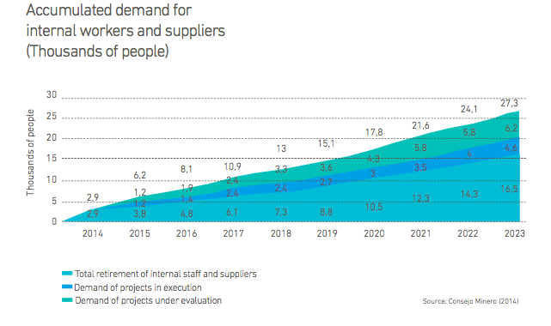
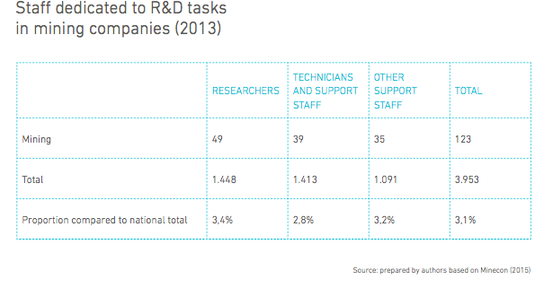
DEVELOPMENT OF HUMAN CAPITAL IN LINE WITH THE INDUSTRY’S CURRENT AND FUTURE NEEDS

Slide 26
Chilean Mining Challenges
Innovation and Sustainability in the Chilean Mining Industry
Francisco Klima
Francisco.klima@fch.cl
Septembre 21st

