Slide 1



September 20-21 2016
The Future of Extractives Industries in LAC and The Role of STI
Linkages and Employment Generation of Extractive Industries of Peru
PhD. Mario D. Tello
Profesor-Investigador
Departamento de Economía
PONTIFICIA UNIVERSIDAD CATÓLICA DEL PERÚ

Slide 2
INDEX
1. Research Objectives
2. Brief Research Methodology
3. Main Results
4. Lessons for LAC
5. Policy Recommendations and Research Agenda

Slide 3
Research Objectives
This paper has two objectives:
1. To estimate the output and employment multipliers of the main products of Peruvian Mining Industry and their linkages with STI and ITC sectors. These products are eleven: copper, gold, zinc, silver, lead, iron, tin, molybdenum, petroleum, natural and liquid gas. In 2014, they have contributed in about 67% of total exports and 13% of the GDP of Peru. Also, they have generated direct employment of 0,1% out of the total labor force.
2. To estimate the geographic or spatial effects of mining centers on the labor force close to these centers.

Slide 4
3. Brief Research Methodologies-O1
Matriz de la Utilización de la Oferta Nacional (356x356)

Slide 5
2. Brief Research Methodologies-O1
The methodology has 4 steps: i) transform the input-output matrix of 365x101 (products-industries) to a matrix of 356x356 (products-products); ii) To estimate the Pure Production Matrix; iii) estimate the output and employment multipliers; iv) estimate the linkages between the eleven mining products and the Science, Technology and Innovation (STI) and Information and Telecommunications (ITC) sectors.
In the first step, the expansion of 101 industries to products was done assuming production and/or employment shares of the products within the industries or splitting the values of the cells product-industry in the numbers of products that the industry is divided. [Note this only affect of the input and output coefficients of the industries that have different products. The IO coefficients of the rest of industries or products are not affected]

Slide 6
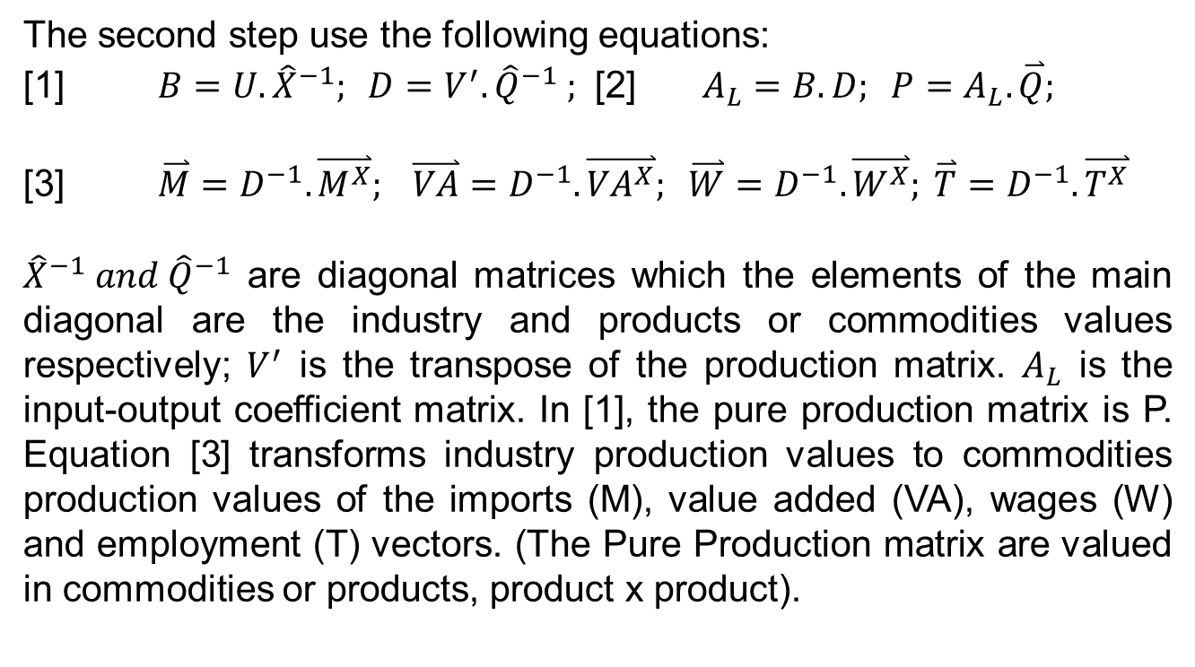
2. Brief Research Methodologies-O1
The second step use the following equations:
[1] $B=U.{\hat{X}}^{−1}; D=V^{′}.{\hat{Q}}^{−1} ;$ [2]$A_{L}=B.D; P=A_{L}.\overset{⃑}{Q};$
[3] $\overset{⃑}{M}=D^{−1}.\overset{⃑}{M^{X}}; \overset{⃑}{VA}=D^{−1}.\overset{⃑}{{VA}^{X}}; \overset{⃑}{W}=D^{−1}.\overset{⃑}{W^{X}}; \overset{⃑}{T}=D^{−1}.\overset{⃑}{T^{X}}$
${\hat{X}}^{−1} and {\hat{Q}}^{−1}$ are diagonal matrices which the elements of the main diagonal are the industry and products or commodities values respectively; $V^{′}$ is the transpose of the production matrix. $A_{L}$ is the input-output coefficient matrix. In [1], the pure production matrix is P. Equation [3] transforms industry production values to commodities production values of the imports (M), value added (VA), wages (W) and employment (T) vectors. (The Pure Production matrix are valued in commodities or products, product x product).

Slide 7
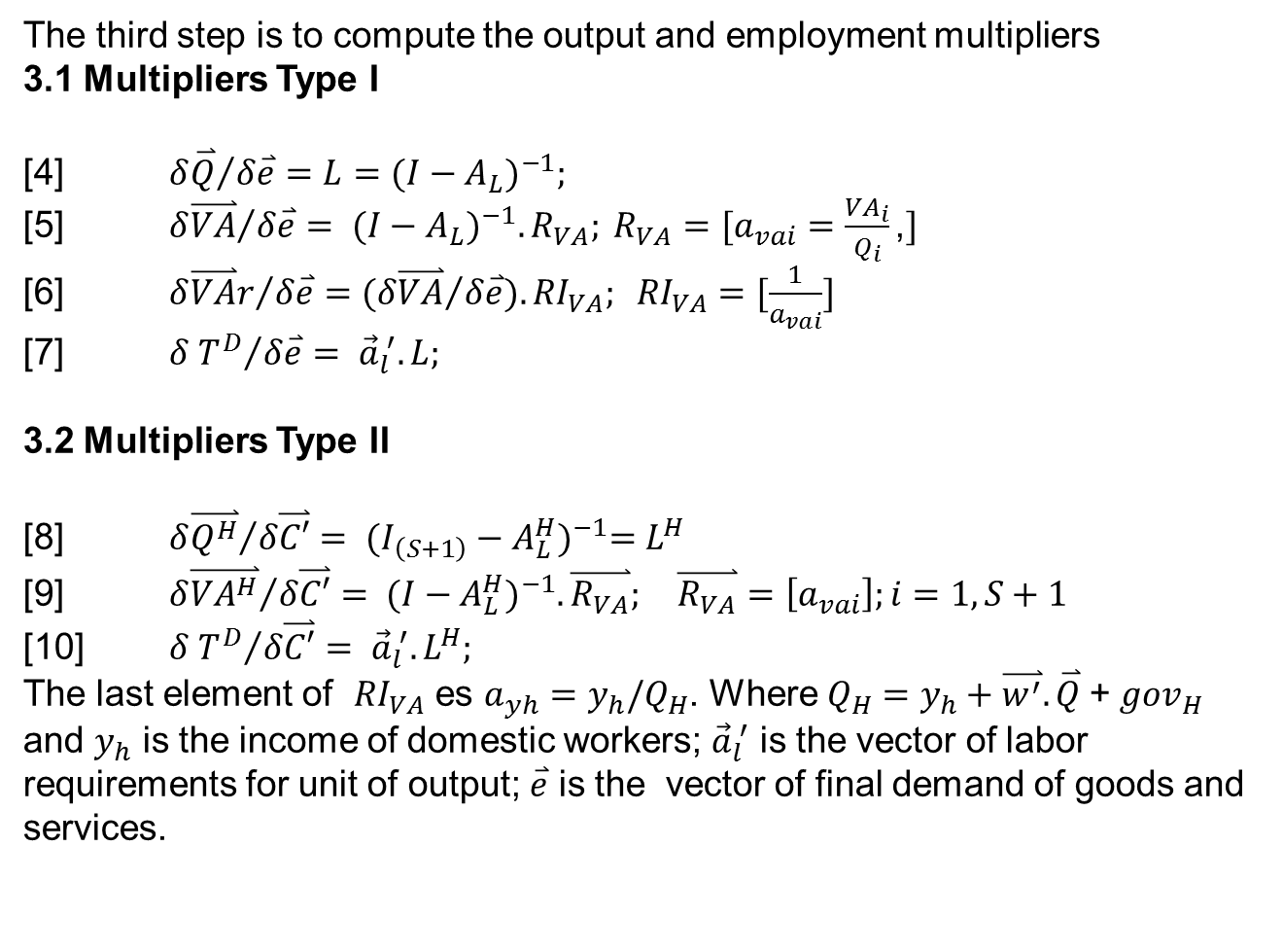
2. Brief Research Methodologies-O1
The third step is to compute the output and employment multipliers
3.1 Multipliers Type I
[4] ${δ\overset{⃑}{Q}}/{δ\overset{⃑}{e}}=L={(I−A_{L})}^{−1};$
[5] ${δ\overset{⃑}{VA}}/{δ\overset{⃑}{e}}= {(I−A_{L})}^{−1}.R_{VA}; R_{VA}=[a_{vai}=\frac{{VA}_{i}}{Q_{i}}\text{,}]$
[6] ${δ\overset{⃑}{VA}r}/{δ\overset{⃑}{e}}={(δ\overset{⃑}{VA}}/{δ\overset{⃑}{e}}).{RI}_{VA}; {RI}_{VA}=[\frac{1}{a_{vai}}]$
[7] ${δ T^{D}}/{δ\overset{⃑}{e}}= {\vec{a}}_{l}^{ ′}.L;$
3.2 Multipliers Type II
[8] ${δ\overset{⃑}{Q^{H}}}/{δ\overset{⃑}{C′}}= {(I_{\left(S+1\right)}−A_{L}^{H})}^{−1}=L^{H}$
[9] ${δ\overset{⃑}{{VA}^{H}}}/{δ\overset{⃑}{C′}}= {(I−A_{L}^{H})}^{−1}.\overset{⃑}{R_{VA}}; \overset{⃑}{R_{VA}}=\left[a_{vai}\right];i=1, S+1$
[10] ${δ T^{D}}/{δ\overset{⃑}{C′}}= {\vec{a}}_{l}^{ ′}.L^{H};$
The last element of ${RI}_{VA}$ es $a_{yh}=y_{h}/Q_{H}$. Where $Q_{H}=$ $y_{h}+\overset{⃑}{w^{′}}. \overset{⃑}{Q}$+ ${gov}_{H}$ and $y_{h}$ is the income of domestic workers; ${\vec{a}}_{l}^{ ′}$ is the vector of labor requirements for unit of output; $\overset{⃑}{e}$ is the vector of final demand of goods and services.

Slide 8
2. Brief Research Methodologies-O1
Type I multipliers measures the direct and indirect effects of changes of final demand. Type II multipliers measures the direct, indirect and induced (household income generation) of changes of final demand.
The four step is the estimation of the output and employment effects for the STI and TIC industries due to changes of the final demand of the eleven mining products and vice versa

Slide 9
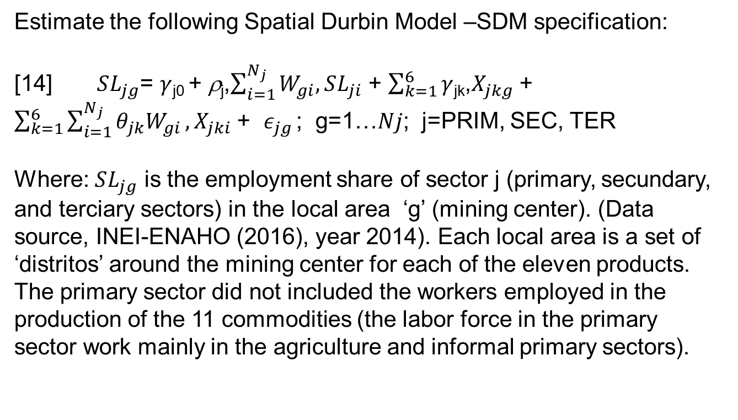
2. Brief Research Methodologies-O2
Estimate the following Spatial Durbin Model –SDM specification:
[14] $SL_{jg}$= $γ$_{j0} + ρ_{j},$\sum_{i=1}^{N_{j}}{W_{gi},SL_{ji}}$ + $\sum_{k=1}^{6}{γ}$_{jk},$X_{jkg}$ + $\sum_{k=1}^{6}{\sum_{i=1}^{N_{j}}{θ_{jk}W_{gi}},X_{jki}}$ + $ε_{jg}$ ; g=1…𝑁𝑗; j=PRIM, SEC, TER
Where: $SL_{jg}$ is the employment share of sector j (primary, secundary, and terciary sectors) in the local area ‘g’ (mining center). (Data source, INEI-ENAHO (2016), year 2014). Each local area is a set of ‘distritos’ around the mining center for each of the eleven products. The primary sector did not included the workers employed in the production of the 11 commodities (the labor force in the primary sector work mainly in the agriculture and informal primary sectors).

Slide 10
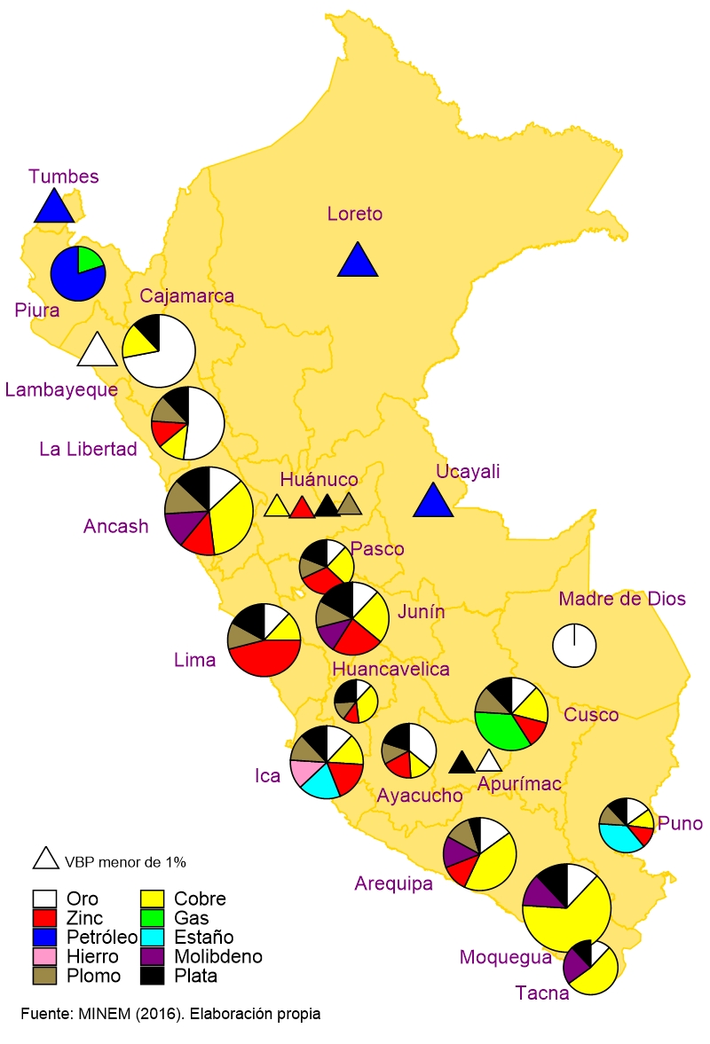
Mining Centers of Peru

Slide 11
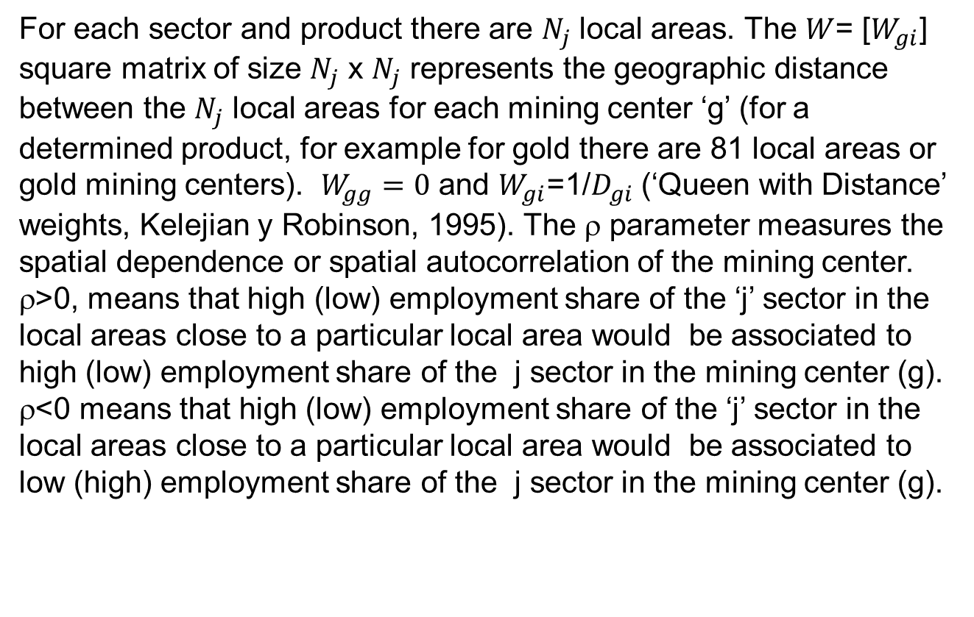
2. Brief Research Methodologies-O2
For each sector and product there are $N_{j}$ local areas. The $W$= [$W_{gi}$] square matrix of size $N_{j}$ x $N_{j}$ represents the geographic distance between the $N_{j}$ local areas for each mining center ‘g’ (for a determined product, for example for gold there are 81 local areas or gold mining centers). $W_{gg}=0$ and $W_{gi}$=1/$D_{gi}$ (‘Queen with Distance’ weights, Kelejian y Robinson, 1995). The ρ parameter measures the spatial dependence or spatial autocorrelation of the mining center. ρ>0, means that high (low) employment share of the ‘j’ sector in the local areas close to a particular local area would be associated to high (low) employment share of the j sector in the mining center (g). ρ<0 means that high (low) employment share of the ‘j’ sector in the local areas close to a particular local area would be associated to low (high) employment share of the j sector in the mining center (g).

Slide 12
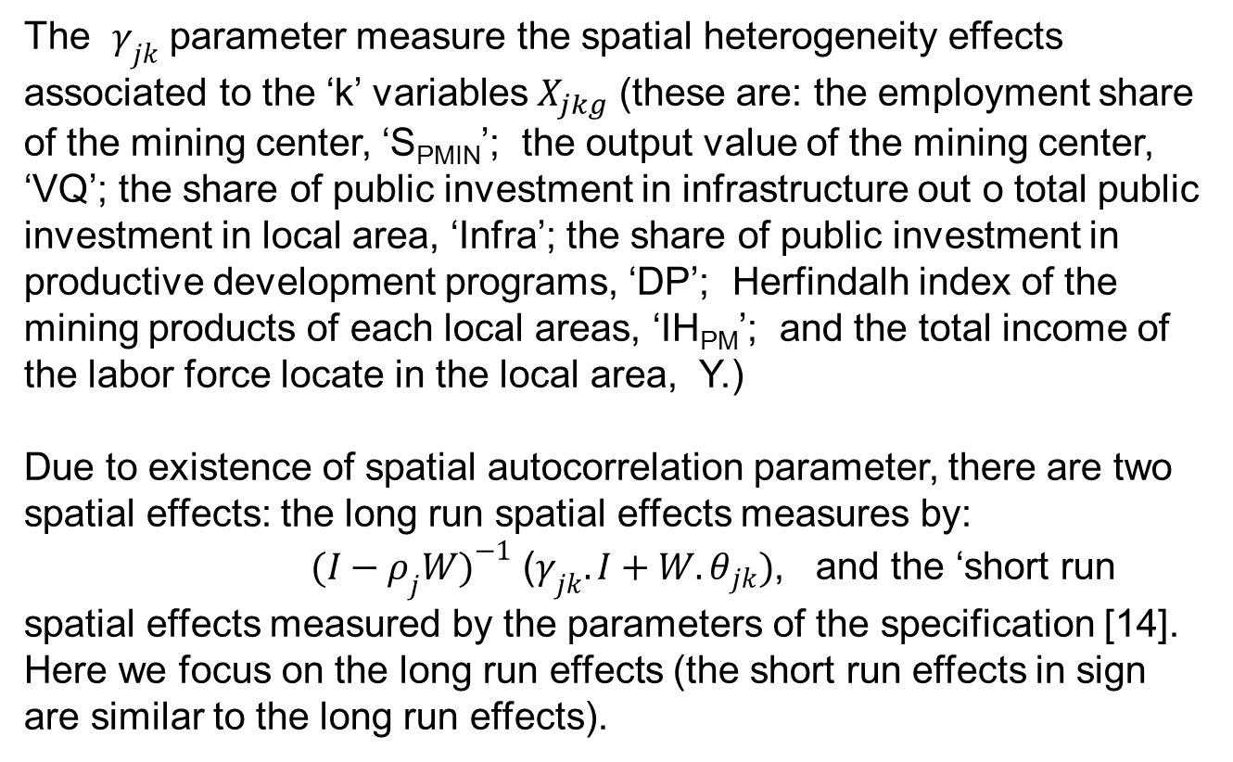
2. Brief Research Methodologies-O2
The $γ_{jk}$ parameter measure the spatial heterogeneity effects associated to the ‘k’ variables $X_{jkg}$ (these are: the employment share of the mining center, ‘S_{PMIN}’; the output value of the mining center, ‘VQ’; the share of public investment in infrastructure out o total public investment in local area, ‘Infra’; the share of public investment in productive development programs, ‘DP’; Herfindalh index of the mining products of each local areas, ‘IH_{PM}’; and the total income of the labor force locate in the local area, Y.)
Due to existence of spatial autocorrelation parameter, there are two spatial effects: the long run spatial effects measures by:
${(I−ρ_{j}W)}^{−1}$ ($γ_{jk}.I+W.θ_{jk})$, and the ‘short run spatial effects measured by the parameters of the specification [14]. Here we focus on the long run effects (the short run effects in sign are similar to the long run effects).

Slide 13
3. Main Results-O1
Output Multipliers (M_{p}), Value Added Multipliers (M_{VA}) and Relative Value Added Multipliers (M_{VAR}), 2007
Productos y Sectores | Tipo I |  |  | Tipo II
 | M_{P} | M_{VA} | M_{VAR} | M_{p} | M_{VA} | M_{VAR}
Petróleo crudo | 1,388 | 0,878 | 1,305 | 1,853 | 1,051 | 1,563
Líquido de gas natural | 1,670 | 0,823 | 1,756 | 2,475 | 1,123 | 2,396
Gas natural | 1,780 | 0,802 | 2,057 | 2,716 | 1,151 | 2,952
Mineral de cobre | 1,395 | 0,853 | 1,328 | 2,436 | 1,241 | 1,932
Mineral de oro | 1,342 | 0,864 | 1,268 | 2,246 | 1,200 | 1,762
Mineral de zinc | 1,254 | 0,883 | 1,181 | 1,924 | 1,132 | 1,515
Mineral de plata | 1,690 | 0,789 | 1,874 | 3,511 | 1,468 | 3,483
Mineral de hierro | 2,285 | 0,715 | 24,210 | 5,676 | 1,978 | 66,966
Mineral de plomo | 1,475 | 0,836 | 1,435 | 2,727 | 1,302 | 2,236
Mineral de estaño | 1,834 | 0,759 | 2,418 | 4,034 | 1,578 | 5,029
Mineral de molibdeno | 1,089 | 0,918 | 1,055 | 1,324 | 1,005 | 1,155
Agregado 11 productos Mineros | 1,377 | 0,859 | 1,783 | 2,347 | 1,220 | 3,210
Resto de productos Mineros | 1,416 | 1,044 | 1,321 | 3,593 | 1,855 | 2,283
Total de Productos Mineros | 1,397 | 0,951 | 1,552 | 2,970 | 1,537 | 2,747
Productos Agropecuarios y caza | 1,258 | 0,875 | 1,243 | 2,205 | 1,228 | 1,739
Pesca | 1,973 | 1,055 | 1,859 | 3,485 | 1,618 | 2,848
Productos Manufacturados | 1,847 | 0,763 | 2,649 | 2,994 | 1,191 | 4,070
Construcción | 1,753 | 0,872 | 1,750 | 3,433 | 1,498 | 3,004
Transporte | 2,247 | 0,932 | 2,691 | 3,606 | 1,438 | 4,271
Servicios de Ciencia, Tecnología e Innovación | 1,580 | 1,015 | 1,506 | 4,019 | 1,923 | 2,838
Servicios de Tecnologías de la Información y Comunicación | 1,622 | 0,870 | 1,665 | 2,984 | 1,377 | 2,640
Administración Pública y Defensa | 1,517 | 0,840 | 1,446 | 4,196 | 1,838 | 3,165
Resto de Servicios | 1,499 | 0,915 | 1,457 | 3,367 | 1,611 | 2,573
Total de Productos y Servicios (356) | 1,658 | 0,909 | 2,077 | 3,081 | 1,698 | 3,656

Slide 14
3. Main Results-O1
Employment Multipliers ML, Type I
Productos y Sectores | Total | Grado de Calificación |  |  | Grado de Formalidad
 |  | A. Calif. | M. Calif. | B. Calif. | Form. | Inform.
Petróleo crudo | 0,0060 | 0,0018 | 0,0016 | 0,0025 | 0,0060 | -
Líquido de gas natural | 0,0104 | 0,0032 | 0,0029 | 0,0043 | 0,0104 | -
Gas natural | 0,0121 | 0,0037 | 0,0033 | 0,0051 | 0,0121 | -
Mineral de cobre | 0,0098 | 0,0023 | 0,0034 | 0,0055 | 0,0041 | 0,7281
Mineral de oro | 0,0085 | 0,0020 | 0,0029 | 0,0041 | 0,0036 | 0,7796
Mineral de zinc | 0,0063 | 0,0015 | 0,0022 | 0,0036 | 0,0027 | 0,8656
Mineral de plata | 0,0171 | 0,0040 | 0,0059 | 0,0027 | 0,0072 | 0,4657
Mineral de hierro | 0,0318 | 0,0074 | 0,0109 | 0,0072 | 0,0135 | -
Mineral de plomo | 0,0117 | 0,0027 | 0,0040 | 0,0135 | 0,0050 | 0,6480
Mineral de estaño | 0,0206 | 0,0048 | 0,0071 | 0,0050 | 0,0087 | 0,3736
Mineral de molibdeno | 0,0022 | 0,0005 | 0,0008 | 0,0087 | 0,0009 | 0,9813
Agregado 11 productos Mineros | 0,0092 | 0,0022 | 0,0031 | 0,0039 | 0,0039 | 0,7585
Resto de productos Mineros | 0,0266 | 0,0093 | 0,0065 | 0,0108 | 0,0108 | 0,3659
Total de Productos Mineros | 0,0179 | 0,0057 | 0,0048 | 0,0073 | 0,0073 | 0,5622
Productos Agropecuarios y caza | 0,1905 | 0,0075 | 0,1420 | 0,0411 | 0,0411 | 0,3921
Pesca | 0,0848 | 0,0027 | 0,0208 | 0,0105 | 0,0105 | 0,4349
Productos Manufacturados | 0,0454 | 0,0050 | 0,0262 | 0,0142 | 0,0142 | 0,5476
Construcción | 0,0353 | 0,0052 | 0,0155 | 0,0146 | 0,0146 | 0,2525
Transporte | 0,0431 | 0,0063 | 0,0137 | 0,0189 | 0,0189 | 0,3954
Servicios de Ciencia y Tecnología | 0,0401 | 0,0218 | 0,0039 | 0,0145 | 0,0145 | 0,4240
Servicios de Tecnologías de la Información y Comunicación | 0,0248 | 0,0087 | 0,0038 | 0,0123 | 0,0123 | 0,4165
Servicios de Administración Pública | 0,0352 | 0,0133 | 0,0082 | 0,0137 | 0,0352 | -
Resto de Servicios | 0,0525 | 0,0120 | 0,0211 | 0,0194 | 0,0194 | 0,5859
Total de Productos y Servicios (365) | 0,0297 | 0,0071 | 0,0227 | 0,0081 | 0,0098 | 0,0199

Slide 15
3. Main Results-O1
Employment Multipliers ML, Type II
Productos y Sectores | Total | Grado de Calificación |  |  | Grado de Formalidad
 |  | A. Calif. | M. Calif. | B. Calif. | Form. | Inform.
Petróleo crudo | 0,0185 | 0,0043 | 0,0083 | 0,0073 | 0,0185 | -
Líquido de gas natural | 0,0321 | 0,0075 | 0,0144 | 0,0126 | 0,0321 | -
Gas natural | 0,0374 | 0,0087 | 0,0168 | 0,0146 | 0,0374 | -
Mineral de cobre | 0,0379 | 0,0079 | 0,0183 | 0,0148 | 0,0148 | 0,0285
Mineral de oro | 0,0329 | 0,0068 | 0,0159 | 0,0128 | 0,0128 | 0,0247
Mineral de zinc | 0,0244 | 0,0051 | 0,0118 | 0,0095 | 0,0095 | 0,0183
Mineral de plata | 0,0662 | 0,0137 | 0,0321 | 0,0258 | 0,0258 | 0,0498
Mineral de hierro¹ | 0,1233 | 0,0256 | 0,0597 | 0,0481 | 0,0481 | -
Mineral de plomo | 0,0455 | 0,0095 | 0,0221 | 0,0178 | 0,0178 | 0,0343
Mineral de estaño | 0,0800 | 0,0166 | 0,0387 | 0,0312 | 0,0312 | 0,0602
Mineral de molibdeno | 0,0085 | 0,0018 | 0,0041 | 0,0033 | 0,0033 | 0,0064
Agregado 11 productos Mineros | 0,0353 | 0,0074 | 0,0171 | 0,0138 | 0,0138 | 0,0266
Resto de productos Mineros | 0,0853 | 0,0209 | 0,0378 | 0,0330 | 0,0330 | 0,0545
Total de Productos Mineros | 0,0603 | 0,0141 | 0,0275 | 0,0234 | 0,0234 | 0,0405
Productos Agropecuarios y caza | 0,2161 | 0,0125 | 0,1556 | 0,0508 | 0,0508 | 0,1965
Pesca | 0,0682 | 0,0095 | 0,0391 | 0,0234 | 0,0234 | 0,0551
Productos Manufacturados | 0,0764 | 0,0112 | 0,0427 | 0,0259 | 0,0259 | 0,0598
Construcción | 0,0807 | 0,0142 | 0,0397 | 0,0318 | 0,0318 | 0,0635
Transporte | 0,0659 | 0,0117 | 0,0281 | 0,0291 | 0,0291 | 0,0533
Servicios de Ciencia y Tecnología | 0,1059 | 0,0348 | 0,0390 | 0,0394 | 0,0394 | 0,0683
Servicios de Tecnologías de la Información y Comunicación | 0,0615 | 0,0160 | 0,0234 | 0,0262 | 0,0262 | 0,0449
Servicios de Administración Pública | 0,1075 | 0,0276 | 0,0468 | 0,0411 | 0,1075 | -
Resto de Servicios | 0,1030 | 0,0221 | 0,0480 | 0,0385 | 0,0385 | 0,0797
Total de Productos y Servicios (365) | 0,078 | 0,016 | 0,038 | 0,0291 | 0,024 | 0,050

Slide 16
3. Main Results-O1
i) High variability of the multipliers. The highest are the multipliers of iron and the lowest ones are the multipliers of copper, gold and zinc which are the main products out of the eleven mining products. The magnitude of the multipliers depends of the backward and forward linkages established in each mining product. These linkages are higher for iron and lower for copper, gold and zinc (see the MVAR);
ii) Type II multipliers are higher than Type values, and output/value added multipliers are higher than employment multipliers

Slide 17
3. Main Results-O1
iii) Employment multiplier generation is higher for skilled (medium and high) workers than for unskilled workers for the eleven mining products
iv) Informal employment multiplier generation is higher than formal employment multiplier generation.
v) The linkages of the STI and TIC sector to the mining sector is lower than the linkages of the mining sector to the STI and TIC sectors. Thus, the output/employment multiplier of these technology sectors due to changes to mining demand are much lower (close to zero) than the output/employment multipliers of mining due to changes to STI and TIC demands. The linkage are higher for TIC sectors than for STI sectors.

Slide 18
3. Main Results-O2
 | PEAO en los Distritos Alrededor de los Centros Mineros
Indic. | Productos Mineros
 | Oro | Plata | Cobre | Zinc | Plomo | Resto²
SL_{PRIM} | 51.4 | 51.6 | 38.6 | 44.3 | 46.1 | 34.5
SL_{PRIM_INF} | 49.3 | 49.1 | 34.4 | 41.0 | 42.8 | 30.4
SL_{PRIM_FOR} | 2.1 | 2.5 | 4.2 | 3.3 | 3.3 | 4.0
SL_{SEC} | 9.7 | 11.4 | 13.8 | 14.1 | 13.4 | 14.3
SL_{SEC_INF} | 6.4 | 7.0 | 7.0 | 7.6 | 7.3 | 8.7
SL_{SEC_FOR} | 3.3 | 4.4 | 6.8 | 6.5 | 6.1 | 5.7
SL_{TER} | 37.4 | 36.6 | 46.7 | 41.2 | 40.3 | 50.3
SL_{TER_INF} | 27.6 | 27.0 | 31.8 | 29.4 | 29.5 | 33.5
SL_{TER_FOR} | 9.8 | 9.6 | 14.9 | 11.7 | 10.8 | 16.8
S_{PMIN} | 1.4 | 0.4 | 1.0 | 0.5 | 0.2 | 0.9
N_{j} | 81 | 89 | 53 | 44 | 43 | 25

Slide 19
3. Main Results –O2
Long Run Spatial Effects of Changes of the Share of Employment in the Mining Sectors
Sector | Formal | Efecto | Productos Mineros
 |  |  | Oro | Plata | Cobre | Zinc | Plomo | Otros
Primario | Formal | Directo | 0,020 | 0,002 | -0,494 | 1,310* | 6,053*** | -0,044**
 |  | Indirecto | 0,024* | 0,109** | -0,120 | 0,236 | 1,783*** | -0,291***
 | Informal | Directo | -0,412 | 1,610 | 3,325** | -1,440 | -7,724 | -6,144***
 |  | Indirecto | -0,240*** | -0,570*** | 0,704** | -0,094 | -2,694*** | -0,109
Secundario | Formal | Directo | -0,050 | 0,215 | -0,755*** | 1,716 | 5,108 | 0,271*
 |  | Indirecto | 0,027** | 0,129*** | -0,133* | 0,111 | 1,488*** | 0,001
 | Informal | Directo | -0,120 | -0,215 | -0,339 | 0,458 | -0,471 | 0,736
 |  | Indirecto | -0,023*** | -0,126*** | 0,028 | 0,138 | -0,102 | -0,300***
Terciario | Formal | Directo | -0,158 | -0,723 | -0,989* | -1,759 | -0,621 | 3,157***
 |  | Indirecto | 0,077*** | 0,113** | -0,25** | 0,102 | 0,718*** | 0,114
 | Informal | Directo | -0,396 | -2,118* | -1,292** | -0,741 | -2,154 | -0,174***
 |  | Indirecto | 0,097** | 0,301*** | -0,140 | -0,309* | -0,308 | 0,467***

Slide 20
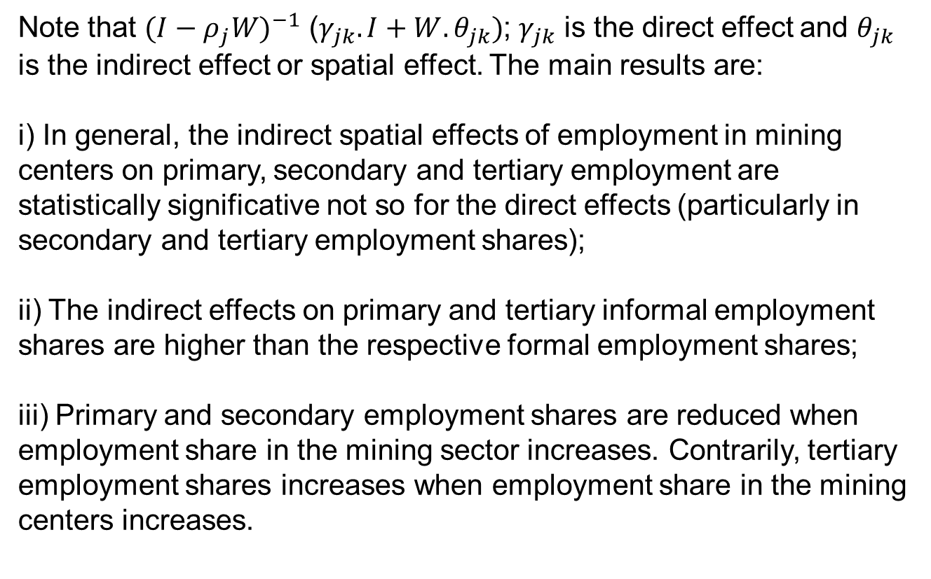
3. Main Results -O2
Note that ${(I−ρ_{j}W)}^{−1}$ ($γ_{jk}.I+W.θ_{jk})$; $γ_{jk}$ is the direct effect and $θ_{jk}$ is the indirect effect or spatial effect. The main results are:
i) In general, the indirect spatial effects of employment in mining centers on primary, secondary and tertiary employment are statistically significative not so for the direct effects (particularly in secondary and tertiary employment shares);
ii) The indirect effects on primary and tertiary informal employment shares are higher than the respective formal employment shares;
iii) Primary and secondary employment shares are reduced when employment share in the mining sector increases. Contrarily, tertiary employment shares increases when employment share in the mining centers increases.

Slide 21
4. Lessons for LAC
i) The size of the employment and output multipliers in extractive industries depend upon the range and magnitude of the forward and backward linkages of the main products of these industries with the rest of sectors. Lower linkages lower multipliers;
ii) The spatial and geographic (long run) effects of employment generation in the mining sector will depend upon of the size of the informal activities around these centers. For economies such as Peru, with high share of labor force employed in informal activities (75% of the labor force in Peru is informal), the indirect effects are higher for informal tertiary sectors.

Slide 22
4. Lessons for LAC
iii) Structural change is negative when resources reallocation effects shifts from high to low productivity sectors. This is the case for Peru, when international prices of the main mining products decreases and employment shares in the mining centers decreases labor force from mining reallocate to primary and secondary sectors with lower labor productivities.

Slide 23
5. Policy Recommendation and Research Agenda
i) Linkages between extractive and the rest of industries need to be promoted either by processing mining commodities or joining to global chains value under fair institutional markets;
As a research agenda:
i) Studies are needed to investigate the role of STI and TIC sectors in extractive industries, particularly how to promote their linkages;
ii) To investigate the role of (formal and informal) small and microenterprises in the extractive industries particularly in external crisis periods;
iii) If income effects increase the induced impacts of multipliers, studies on the legal framework of the transfer revenues of extractive industries and its effects upon sectors and local areas are needed.

Slide 24
MUCHAS GRACIAS…..

