Slide 1
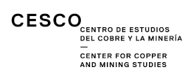
Discovering new public-private partnership for productive and technological developing in emerging mining countries
Jakob Baumann, Investigator , UNU-MERIT
Michiko Iizuka, Research Fellow, UNU-MERIT
Osvaldo Urzúa, Investigator for REDSUR project
Fernando Vargas, Investigator , UNU-MERIT
Alejandra Wood, CESCO investigator

Slide 2
Motivation
The extractive industry has the potential to increase knowledge intensity and support economic diversification: How?
Context/debate:
LA has shown the potential of sustaining growth and building up technological capabilities based on the extractive industry.
This has been an evolutionary process and now LA need to transit into a innovation-driven economy
What is the role of policy interventions, in particularly with regards to demand side approach and public-private partnership?
RQ: Is Public-Private Partnership a viable answer for effective policy interventions? If so, what are the possible barriers for the successful outcome?
This investigation explores barriers by looking at two programs on supplier development in mining sector of Chile and Peru

Slide 3
Development of mining equipment, technology and services (METS)
High-value local content and economic diversification
Operations and investments
Downstream processing activities
Closure
exploration
mining
processing
Intermediate
Products
Manufacturing
Knowledge intensive products/services
Equipment, technology and Services
METS:
Mining Equipment, Technology & Services …and more
Knowledge exports
Entering in global value chain
Hi-tech
Industries

Slide 4
How to deliver the full development potential of NR?
Involve knowledge, technology and institutions to coordinate relevant actors to diversify NR-based activities
Capabilities and learning efforts in systemic context: still necessary for mining sector in LA
Catching up in capability (evolutionary process): From production, to improve and innovate (Viotti, 2002)
Local specificity of knowledge (Perez, 1990, Marin et al, 2015, Katz, Iizuka, Soete, 2013)
Local competitive market conditions (Porter, 1990) create a ground for new development of technology (KIBS).
Policy:
Stimulating the investment in learning and innovation activities
Intervention involving market demand forces (demand side approach): market needs to potential producers (lower transaction costs)
Reducing risks to induce investment and coordination failure
Possible to create positive externalities with right policy interventions

Slide 5
Transforming natural capital into social capital
Creating new capabilities by tackling new challenges: An demand driven agenda
SOCIAL CAPITAL
GEOLOGICAL CAPITAL
(Natural Capital)
Applying capabilities in real
production processes - Absorption
Capabilities in the mining sector (Ecosystem)
Developing new capabilities driven by productive,
environmental and social challenges - learning
The ore deposits and the associated operations face increasing production, trade, environmental and social challenges of increasing complexity
Productive and managerial
Human capital
Technological capabilities
Infrastructure and services
Institutional capabilities
Others

Slide 6
Broad benefit from Public –Private Partnership
Cost sharing arrangements with industry lead R&D+i with targeted support form public sector
Building trust and personal networks which facilitate further formal and informal cooperation.
Effective way to mobilize private financial resources and competencies in pursuing government missions
Provide easier access to research output and facilitate the creation of new technology based firms, spin offs and researcher mobility between public and private
Linking small and medium enterprises with scientific research
Increased synergies via better inter-ministerial coordination and also with subnational regional levels.
Source: based on OECD, 2014

Slide 7
Complementary role of Private and Public sectors
 | Private sector | Public sector
Advantages for involving in policy making | Provide: Information on market, Business opportunities, Technological frontiers ; Financial resources ; International alliances | Provide: Holistic and long term vision on development; Ability to take long term risk; Some resources for collective (social) public good; Coordination among public sector and with private sector
Challenges for involving in policy making | Potential capture (corruption), Risk averse, Short term vision, Competition between firms, difficulties in coordination | No information on market, business opportunities, technological frontiers, Limited financial resources,

Slide 8
Development of mining equipment, technology and services (METS)
Local supply chain development, an evolutionary process made of successive stages
_
Productivity
Social and environmental performance
+
Internationalization and economic diversification
Chile today (2016)
Stage III
Creating an innovation
ecosystem
Stage II
Creating local
supply chain
Chile in 1990
Innovation ecosystem
and METS exports
Stage I
Incubating critical capacities
Consolidation of a local
supply chain
Transition period
How to support succeeding transiting to the next stage ?
Factor-driven
economy
Investment-driven economy
Creating productive and absorptive capabilities
Innovation-driven economy
1975
1985
1995
2005
2015
2025
2035
Comparative advantages
Comparative advantages

Slide 9
Development of mining equipment, technology and services (METS)
An overview of the Chilean case: Evolution and projected scenario
Low income country
Low income country
Middle income country
High income country
Factor-driven economy
Investment-driven economy
Innovation-driven economy
Mining Enclave
Comparative advantages
Comparative advantages
Stage I
Incubating
critical productive
capacities
Stage II
Creating
a local
supply chain
Stage III
Creating an
innovation
ecosystem
Internationalization
and economic diversification
Source of competitiveness
Productive and technological capabilities built up
Origin of advanced solutions and technologies used
Exports
Rich endowment of high quality minerals (competitive advantage)
Large-scale mining production system (critical size)
Outsourcing provides an initial boost to the emergence of local suppliers (still of little relevance)
Mainly through imports
Copper
Rich endowment of minerals
Gains in productivity generated by strong investment (FDI, scale, new practices and new equipment)
Growth of large-scale production
Increase sophistication of local supply chain (technology transfer, adaptions , design and engineering capabilities)
Mainly from abroad – imports
Local presence of OEMs and other international suppliers
Mainly copper
Local suppliers start exporting, but low amounts
Rich endowment of minerals , but of lower quality
High level of technological, managerial and institutional capabilities boost productivity and socio-environmental performance
Share of world copper production maintained (30%) and growth in other minerals
Sophisticated medium size mining companies emerge
Local supply chain with high technological capabilities to meet the challenges of productivity and sustainability.
Imports from abroad remain significant
OEMs with more sophisticated capabilities at local level
Local innovative solutions (METS) in niches becomes a source of competitive advantage.
Main export: copper + others minerals
Significant exports of METS to the mining industry and other sectors (diversification)
1965
1975
1985
1995
2005
2015
2025
2035
Year
Source: Urzua, O. - Lecture notes, MBA, Industrial Engineering Department, University of Chile.

Slide 10
The World-class supplier program (Chile) A structured and systematic process
Source: BHP Billiton

Slide 11
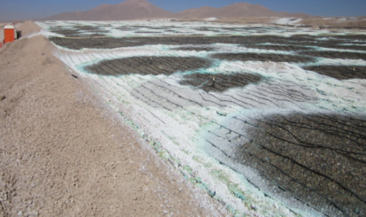
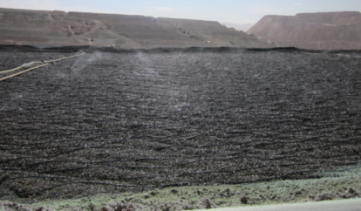
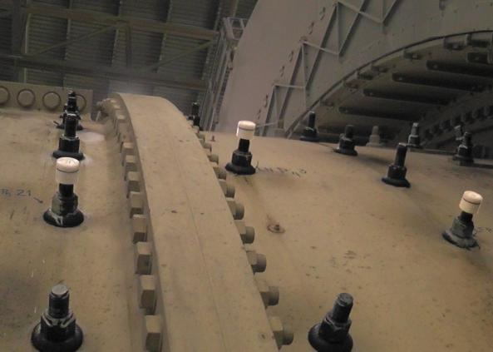
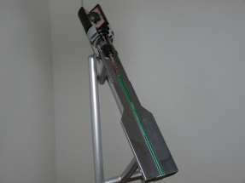
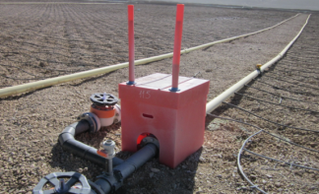
Creating value for the business and building capabilities
Examples of collaborative innovation projects
BHP Billiton (Escondida)
Goal: Increase leach pads recovery by assuring leaching plan
Benefits
Productivity: Reduced irrigation deviation by assuring leaching plan.
Recovery: Increase by 2% copper recovery in oxide leach pads
Increased 0,95% copper recovery in sulphide pads.
Increase copper production by 3.170 Tons per year
BHP Billiton (Escondida)
Goal: Online monitoring system of the erosion level in the SAG mill, maintaining a 95% of the prediction precision
Benefits
Productivity: Prevents stopping the sag mill in order to identify the degree of erosion of its liners, thus optimizing PM and SD planning (46 hours of potential saving)
Cost saving: liners can be pushed to the limit with minimum risk
Source: BHP Billiton

Slide 12
Escalating the World-class supplier program
Case - World-class suppliers BHP Billiton (Chile)
Ongoing projects: 4 (2009)
Suppliers: 4
Num. of mining companies: 2
Coordination/acceleration Platform. -
Link to smart money (“VC”) -
Government support: Endorsement
Large suppliers (EOM): -
Portfolio approach (R&D+i) -
20 - 30(2015)
20 (~100 suppliers participated)
2 + 1
↓ time to market ✗
✗
4 innovation projects
✗
✗
25 - 35
4 - 5
↓time to market + ↑export.
✓
National policy (Alta Ley Program)
2 - 3
✓
Today
2016 – 2024
Escalating and consolidation
2011 – 2015
Process & structure
Main goals
Projects successfully scaled up
Stable structure and processes:
Innovation projects portfolio approach
Diversified portfolio (timing and complexity).
Portfolio renewal process on-going
Full integration in BHPB processes
2009 – 2010
Piloting
Main goals
Processes designed and testing
Public good design (Platform – FCh)
Main goal
Creating capabilities and learning
Building a case (business case and development case)
Source: BHP Billiton
Peru: The program stated in 2012 and similar steps are taken.
The number of participating firms from 48 in 2013 to 86
Participating university increased from 6 to 10
RQ: What are the barrier that inhibit escalating the programs to support structural change?

Slide 13
Methodology applied
Semi structured interviews were conducted to key stakeholders (in Chile and some in Peru): Mining firms, supplier firms, university or research centers and experts (academia, etc.), and policy makers
Asking them to list existing barriers in each actors
According to the following categories of ‘barriers to scaling up’:
Increase number of collaborative innovation project
Increase the share of complex innovative projects (balanced portfolio)
Reduce the time to market of collaborative innovation projects
Increase exports to new markets and new clients
Aim: to explore types of barriers inhibiting the scaling up of this program

Slide 14
Results1 Chile : Barriers identified (By entity)
Mining (Path dependent ):
Narrow criteria on procurement decision (transactional)
Limited experience in dealing with collaborative learning and innovation processes carried out in Chile
Positive externality created (i.e. capacity building of the local firms) are not in KPI (Key performance indicators)
Local Suppliers
Lack of capacities in scaling up technologies and manage innovation processes
Lack of experience, international exposure.
Lack of scale and resources
Lack of testing sites for their prototype (mining sites).
University, Laboratory and research institutions
Lack of public-private and industry–university interactions
No incentive/nor prior history for mission oriented research
Too much academic research orientation (publication)
Government
Not providing sufficient incentives for mining company and suppliers to collaborate
Lack of local regulations, government interventions to create market and correct misalignment of incentives.

Slide 15
Result 2 (Chile): Barriers identified (By type of scaling up)
Increase number of collaborative innovation project
Misalignment of incentives to collaborate: mining firm, supplier, university
Lack of financial resources to finance long term collaboration
Increase the share of complex innovative projects
Firms’ incentive mechanism do not favor involved in complex innovation project
Mining company ‘s risk aversion due to lack of capacity in local firms.
Long term mistrust between research institution and firms regarding IPR
Lack of local supplier capability to take prototype to the market
Lack of ability for suppliers to finance long term project
Reduce the time to market
Mining company: aversion to risk, lack of collaborative culture with supplier
Suppliers’ lack of long term finances
Supplier’s lack of capability to form networks
Increase exports to new markets and new clients
Risk averse suppliers, lack of entrepreneurial spirit, experience and access to external linkage
Lack of experience among suppliers particularly in IPR management, discovering new markets

Slide 16
Discussion: problems and possible solutions
Mining firms
-Lack of investing in Local R&D+i caused by risk aversion. Partially explained by the low capacity level of local suppliers, partially explained by the managerial (routine) decision making which goes via HQ or KPI
Potential solution: Public good to coordination to lower risk premium via cost sharing (via contributing to the proportion of positive externalities created by mining firms)
Local suppliers
-Highly heterogeneous in capacity and type of economic activities
-Restricted credit access (smart money) to engage in long term investment
-In general lacking various types of capabilities
-Lacking public infrastructure-testing prototype, laboratory and certification
Potential solution: Providing better credit access, capacity building, mentoring on specific areas (scaling-up technologies, export, marketing , etc). Providing/coordinating testing sites for prototype for better market access
University
- Too much focus on academic works than actively engaged in productive development (mission oriented R&D+I led by the industry)
Potential solution: Create incentive mechanisms for researchers and university to engage in private sector led research. Identification of specific theme and appointing ‘center of excellence’ based on competitions . This may also involve university evaluation system. Mining firm financed professorial position or higher education course/ fellowship in university

Slide 17
Transforming natural capital into social capital
Two interconnected cycles to acquire, assimilate and apply new capabilities
Social capital
Existing capabilities updated and improved (P&S + environment)
Geological capital
Applying existing capabilities to process existing reserves
Existing solution
(P&S + Context)
Continuous improvement cycle
Reserves
in production
(Return of investment)
Existing Capabilities
(P&S + context)
Capability at firm and context levels
Ore deposits and operations
Scaling up - Industrial and Commercial
Institutional upgrading
New capabilities and higher level of reserves are
created (New P&S + Sophisticated environment)
Applying existing + additional capabilities to expand the reserve base
New solutions
Learning and innovation cycle
New reserves to feed production
(Return of investment)
New Capabilities
(P&S + Sophisticated context)

Slide 18
Conclusion
Principal benefits outlined in the P-P-P is well suited for the current context of policy intervention.
Since 2008, Mining sector in Chile tried to develop knowledge based suppliers with leadership of Private sector (BHP Billion). This lead into PPP. (this is followed by Peru’s case)
The outcome of the program is positive, the challenges is escalating these program
Misalignment of incentives within each actor’s behavior seems to have inhibited ‘scaling up’ process in virtuous circle.
Capacity upgrading of policy maker on demand side policy approach is very much needed in this context

Slide 19
A way forward for future? A new enabling paradigm for mining economies to play a leading role in the 21st Century
20th Century
21st Century
Axis that frame the debate
Axis that frame the debate
Natural Resources as knowledge-based activity
Natural Resources
(Minerals)
Mining economies in the 21st Century
The Chilean experience
What is the next stage?
Transactional relationship
State-Market
Public-Private Partnership
State
Market
20th Century
An urgent transition
How set it up?
Knowledge
Technology
Natural Resources as rent seeking activity

Slide 20
The link between competiveness and sustainable development Transforming geological capital into social capital
Social Capital
Geological Capital
(Natural Capital )
Strengthening social license to operate and grow granted by the host society (communities) due to the impact as an engine of sustainable development
External Factors
Level of capabilities ~ Development :
Operational
Socio – environmental
Institutional & legal
Host Society
+
engagement
relationship
Mining resources & reserves
Mining companies
Attracting talent due to the opportunity for personal and professional development
Internal Factors
+
Investors (shareholders)
$
Attracting investment triggered by the of return on investment and cash flow generation
$
Investment opportunities
at global level
Source: Urzua, O. - Lecture notes, MBA, Industrial Engineering Department, University of Chile.

Slide 21
Broader view of the external factors Embracing the complexity of sustainable mining
Stakeholders Stakeholders Stakeholders Stakeholders
Operational factors
Socio-environmental factors
Legal & Institucional factors
Relationship
style
2
3
No interaction
(enclave)
Human
Capital
1960s
1
Financial Capital
Transactional relationship
Energy and water
4
Mineral resources
Regulation, enforcement , subsidies & institutions
- Values & Culture -
12
Suppliers Universities and R&D centres
+
Safe, competitive and stable operations and investments
Taxes and
fiscal regime
5
Strengthening the competitiveness of the base while driving socioeconomic and environmental development at all levels
Infrastructure Public goods and Logistic
Time
11
Society
6
Quality of life in cities
10
Environment & nature
Indigenous Communities
Communities
7
Collaborative relationship
(integrate and transform)
9
8
2030s

Slide 22
How to deliver the full development potential of a sustainable mining industry?
What institutional arrangement is required?

