Slide 1
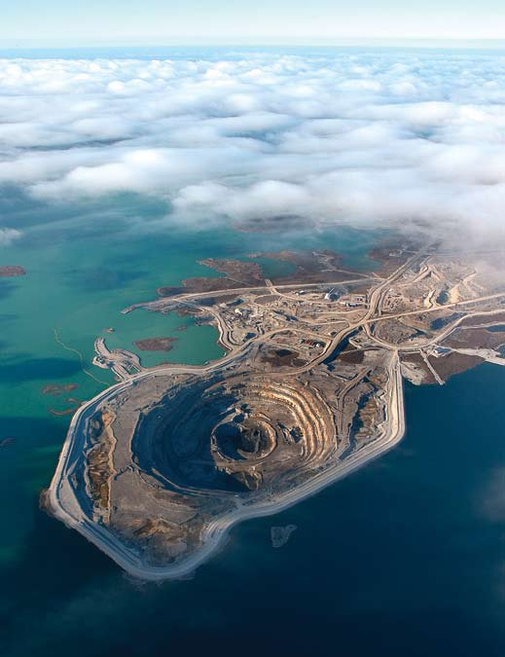
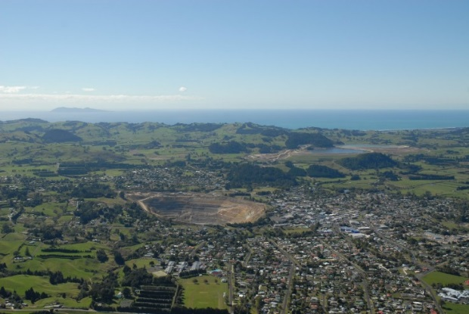
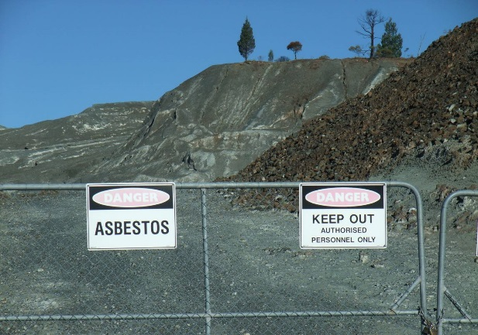
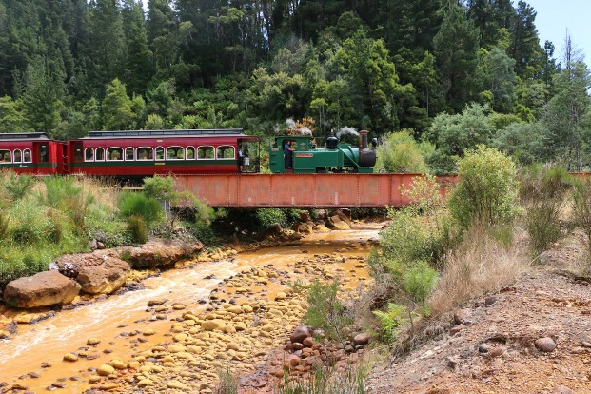
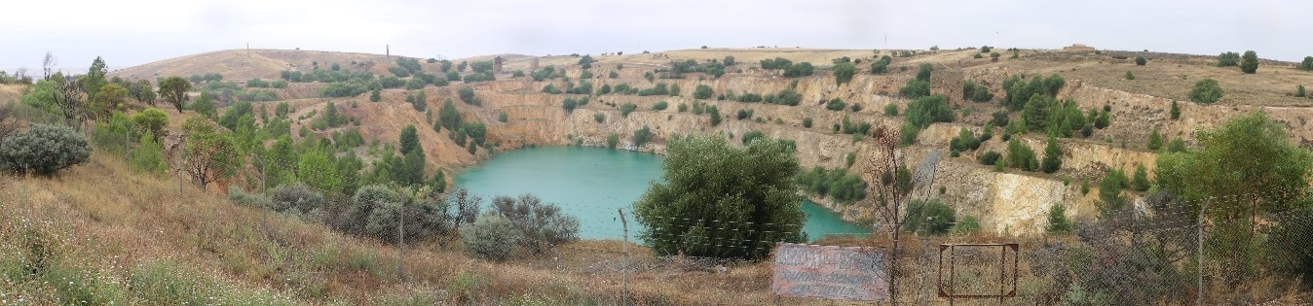
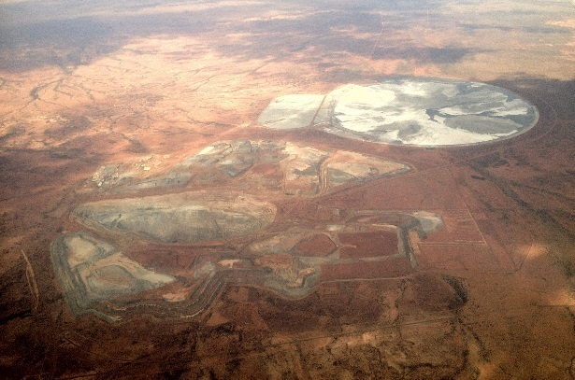
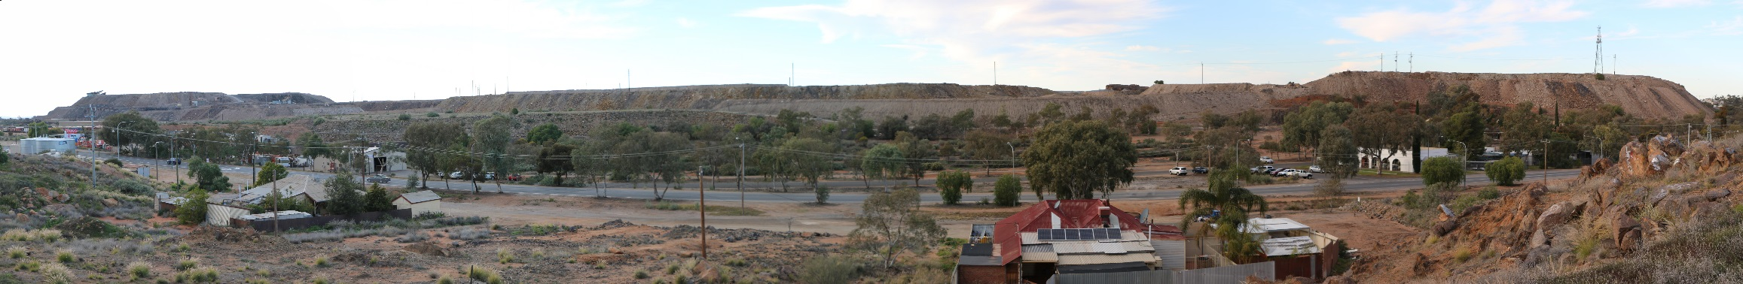
Sustainability Challenges for the Mining Industry
Dr Gavin M. Mudd
Environmental Engineering, Monash University (RMIT from 2017)
Workshop: ‘Future of Extractive Industries in Latin America
and the Caribbean and the Role of Science,
Technology and Innovation’
Buenos Aires, Argentina, 21-22 September 2016

Slide 2
Georgius Agricola (1556):
“Nay, if I understand anything, greater wealth now lies hidden beneath the ground in the mountainous parts of your territory than is visible and apparent above ground.” (page xxxi)
“… the strongest argument of the detractors is that the fields are devastated by mining operations … Also they argue that the woods and groves are cut down, for there is need of an endless amount of wood for timbers, machines, and the smelting of metals. And when the woods and groves are felled, then are exterminated the beasts and birds, very many of which furnish a pleasant and agreeable food for man. Further, when the ores are washed, the water which has been used poisons the brooks and streams, and either destroys the fish or drives them away. Therefore the inhabitants of these regions, on account of the devastation of their fields, woods, groves, brooks and rivers, find great difficulty in procuring the necessaries of life … Thus it is said, it is clear to all that there is greater detriment from mining than the value of the metals which the mining produces.” (page 8)
“De Re Metallica”, 1912 Hoover Translation, Dover Publications (1950).
Mudd: Sustainability Challenges v Modern Mining

Slide 3
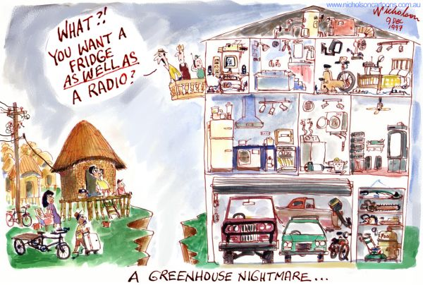

Slide 4
Presentation Overview
Sustainability and mining – beyond the paradox
Key Mega-Trends in Mining
  growing production, declining ore grades, more tailings & waste rock, more difficult resources …
Key Environmental Issues
  water resources risks, acid mine drainage, mine site rehabilitation, tailings & waste rock management, energy & carbon issues, …
Possible Solutions: Sustainability Reporting
New Technologies?
Summary
Mudd: Sustainability Challenges v Modern Mining

Slide 5
‘Sustainable’ Mining?
Modern mining is vast in scale and complexity – but at heart it means to deplete something … yet we know of more mineral resources than ever before and continue to grow production to record levels and ever more minerals and metals
Following the ‘Mining, Minerals & Sustainable Development’ (MMSD) project presented to the 2002 Earth Summit, the global mining industry changed focus to embrace sustainable development – not that a single mine is truly sustainable, but that mining can contribute to sustainable development goals
This change in ‘mining philosophy’ is important !!
Read Dr Daniel Franks’ book “Moving Mountains” for a great review of this …
Mudd: Sustainability Challenges v Modern Mining

Slide 6
Increasing Production …
Mudd: Sustainability Challenges v Modern Mining

Slide 7
Increasing Resources …
Mudd: Sustainability Challenges v Modern Mining

Slide 8
Ore Grades: A Key Driver
Ore grades is how much metal (or mineral) is present in every tonne of rock processed to extract that metal …
In general, ore grades are in terminal decline, although much more gradual now than decades ago
Increasingly, ores are also becoming more ‘refractory’ or difficult to process, meaning more effort (chemicals, energy)
For some resources, metal grade is considerably less important than the host minerals and the presence of impurities
  Iron ore: hematite vs magnetite ores, impurities such as alumina, silica, …
  Copper: presence of uranium, arsenic, mercury, etc …
  Heavy mineral sands: radioactive monazite …
Mudd: Sustainability Challenges v Modern Mining

Slide 9
Declining Ore Grades …
Mudd: Sustainability Challenges v Modern Mining

Slide 10
Ore Grades vs Global Cu Resources
Mudd, Weng, Jowitt, 2013
Skinner’s 1976
“Mineralogical Barrier”
for geochemically scarce metals
Mudd: Sustainability Challenges v Modern Mining

Slide 11
Declining Ore Grades …
Mudd: Sustainability Challenges v Modern Mining

Slide 12
Increasing Waste Rock …
Mudd: Sustainability Challenges v Modern Mining

Slide 13
Summary: Key Mining ‘Mega-Trends’
Production:
Growing Fast
Ore Grades:
Gradually Declining
Resources:
Growing Fast (?)
Mine Wastes:
Growing Rapidly
Mudd: Sustainability Challenges v Modern Mining

Slide 14
Key Environmental Issues in Modern Mining
Major environmental issues facing modern mining include water resources risks & impacts, air pollution, greenhouse gas emissions & climate change, acid mine drainage, rehabilitation, growing energy needs, etc …
There are many examples of poor environmental performance – right across the world – and this drives community concerns at existing or proposed projects
Rise of internet and the digital age – especially social media – means communities can learn of these examples easily & quickly
Mudd: Sustainability Challenges v Modern Mining

Slide 15
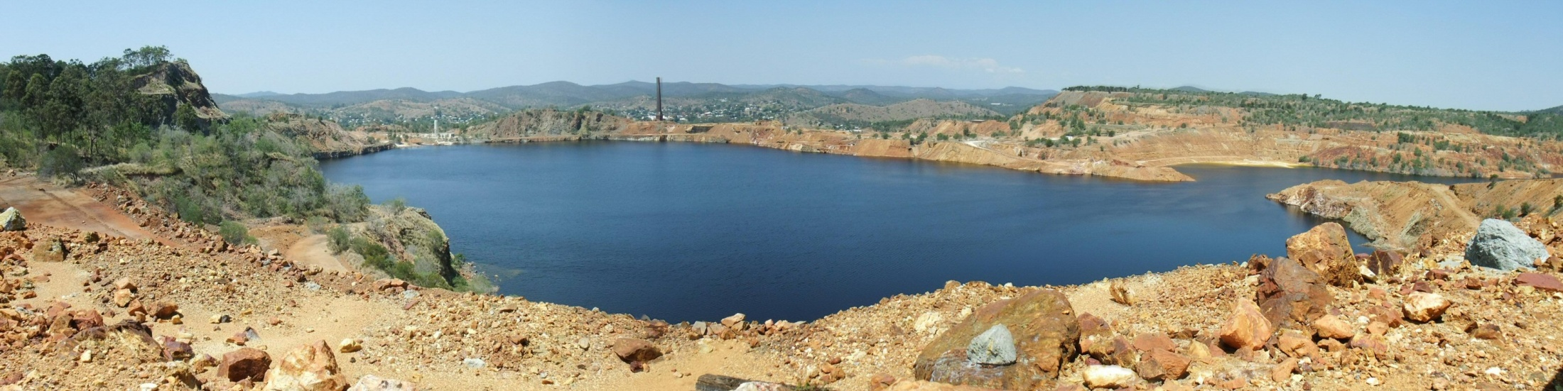
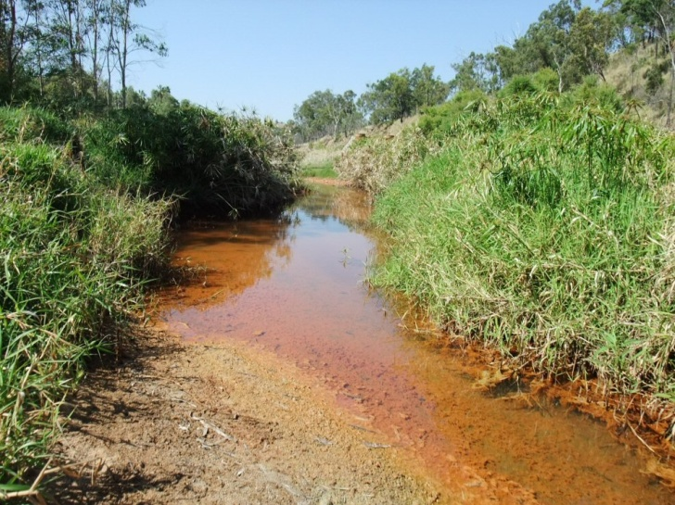
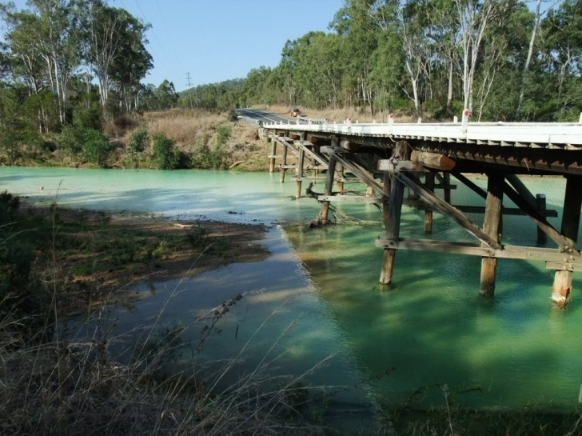
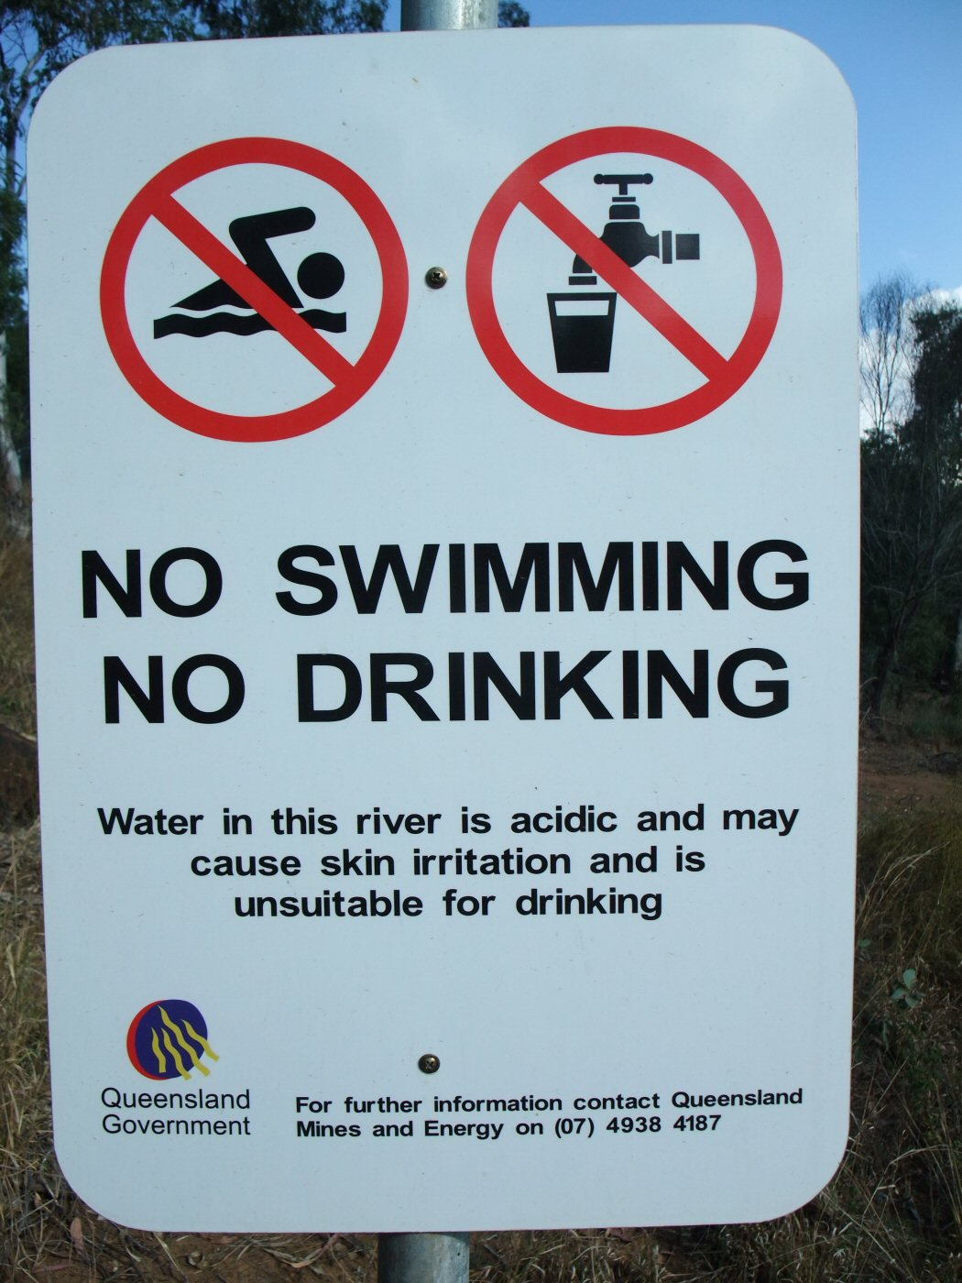
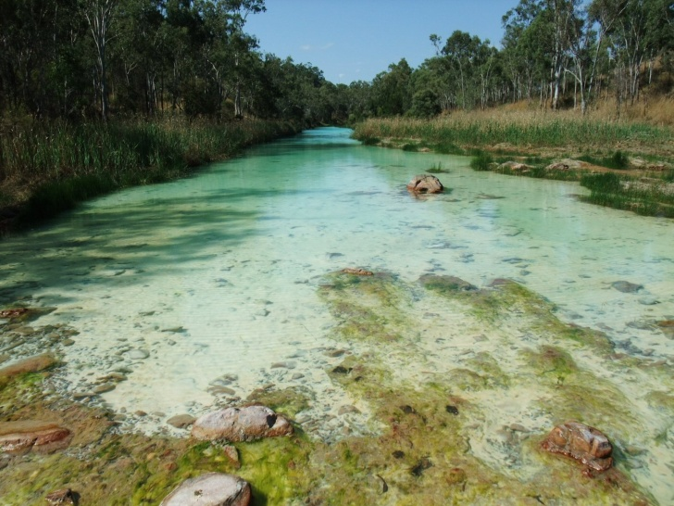
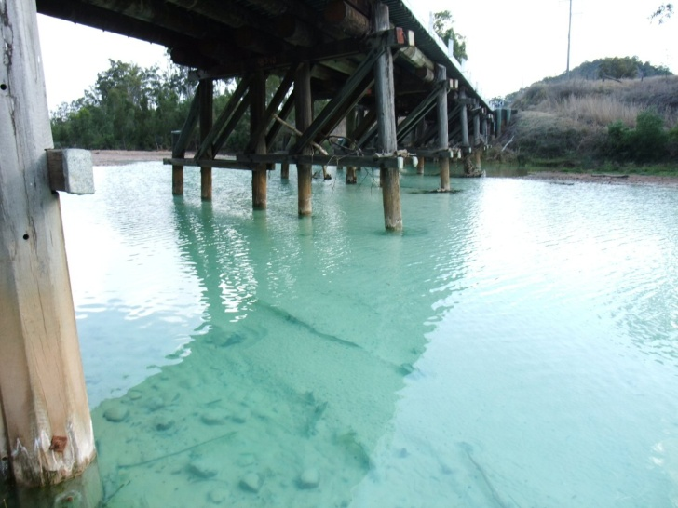
Mt Morgan Au-Cu, Qld

Slide 16
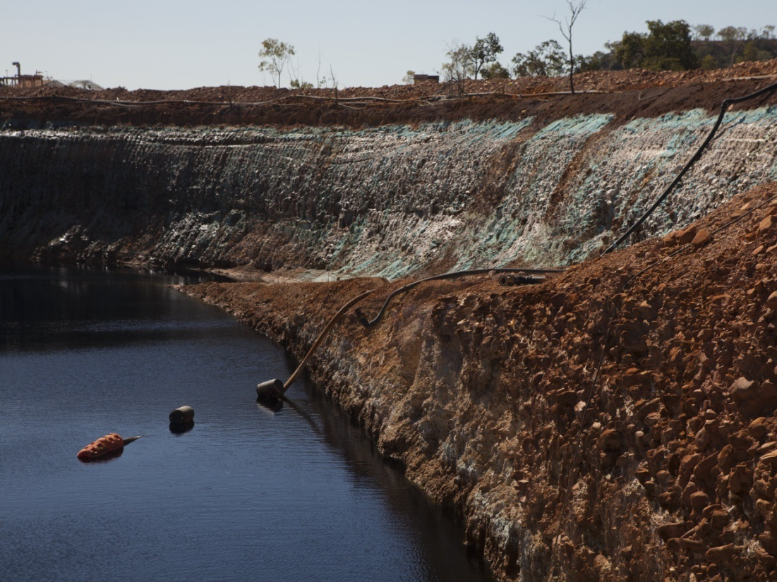
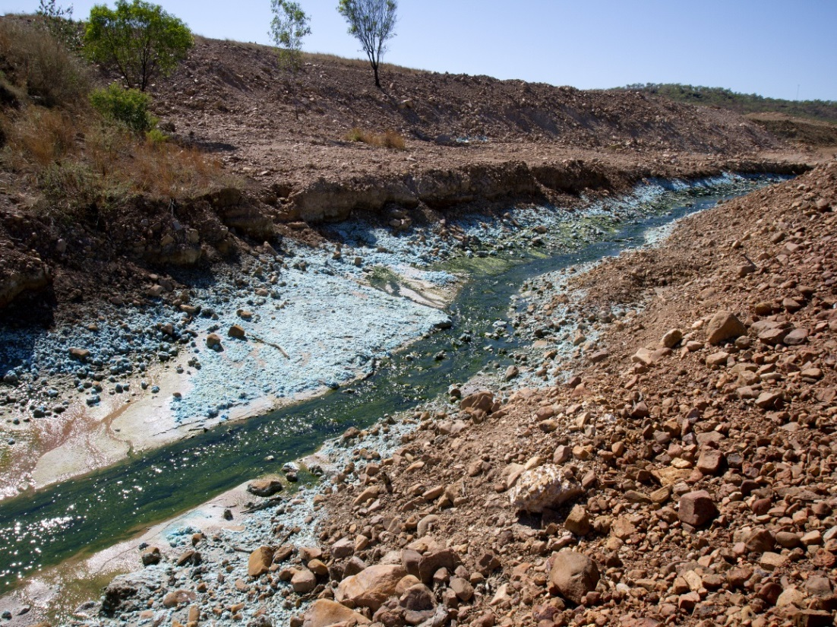
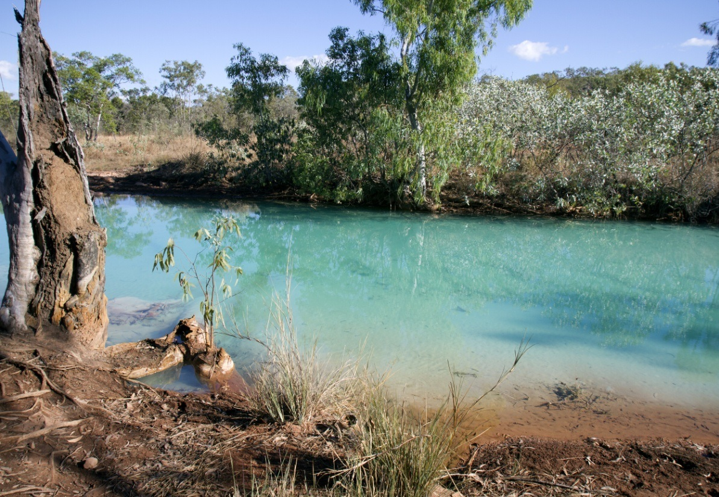
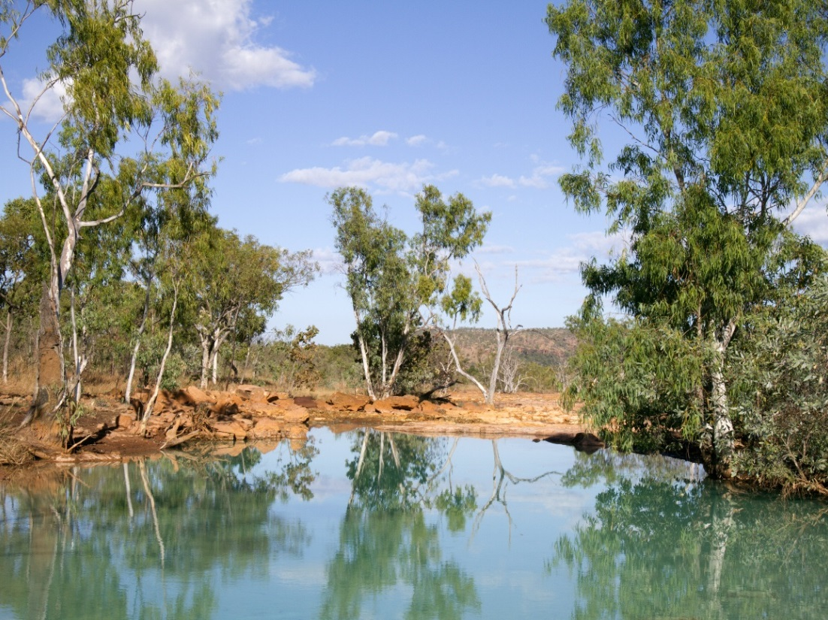
Redbank Cu, NT
WRD Seepage: pH 3.3

Slide 17
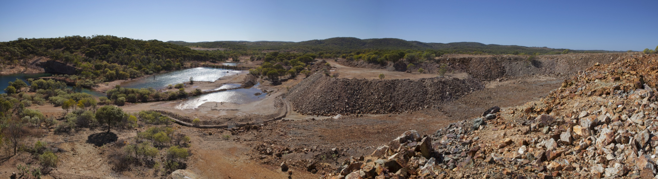
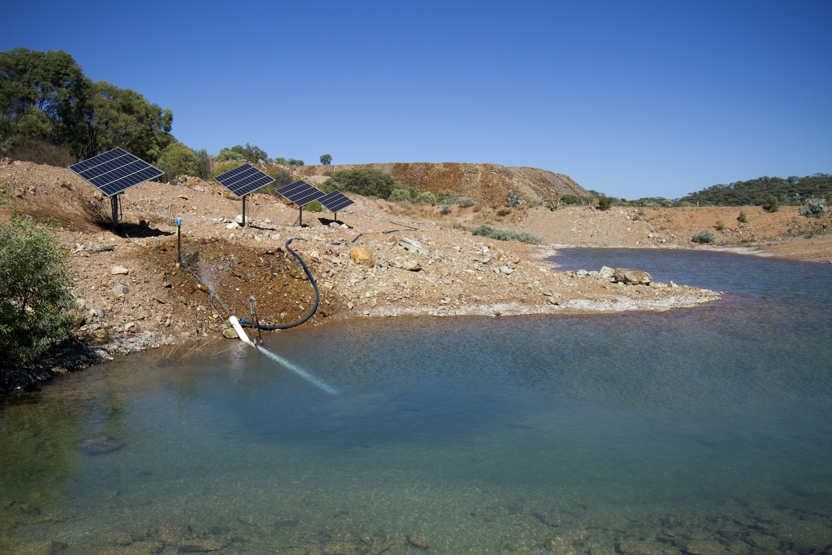
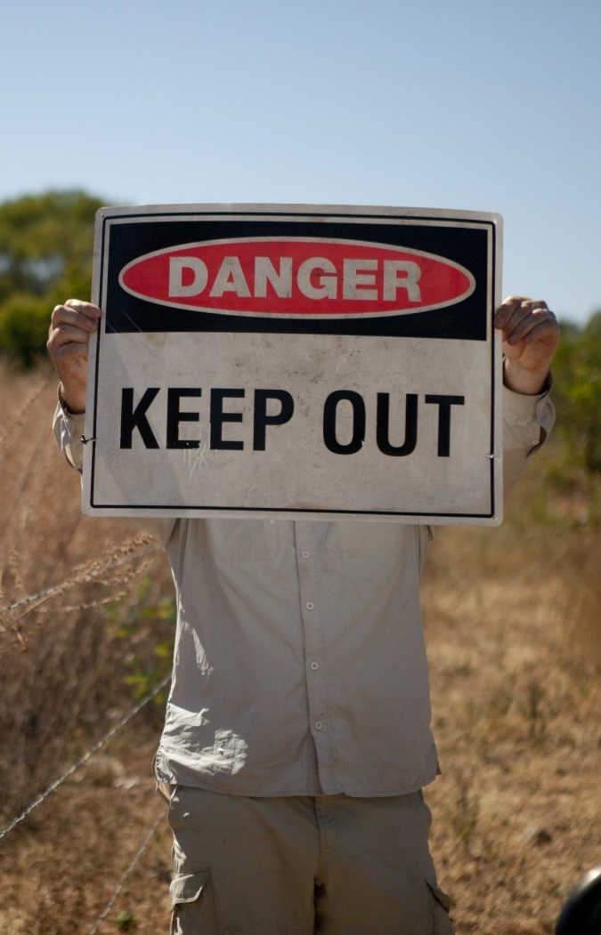
Tabletop Mine, Croydon, Qld
No Obvious AMD …
BUT pH 3.5

Slide 18
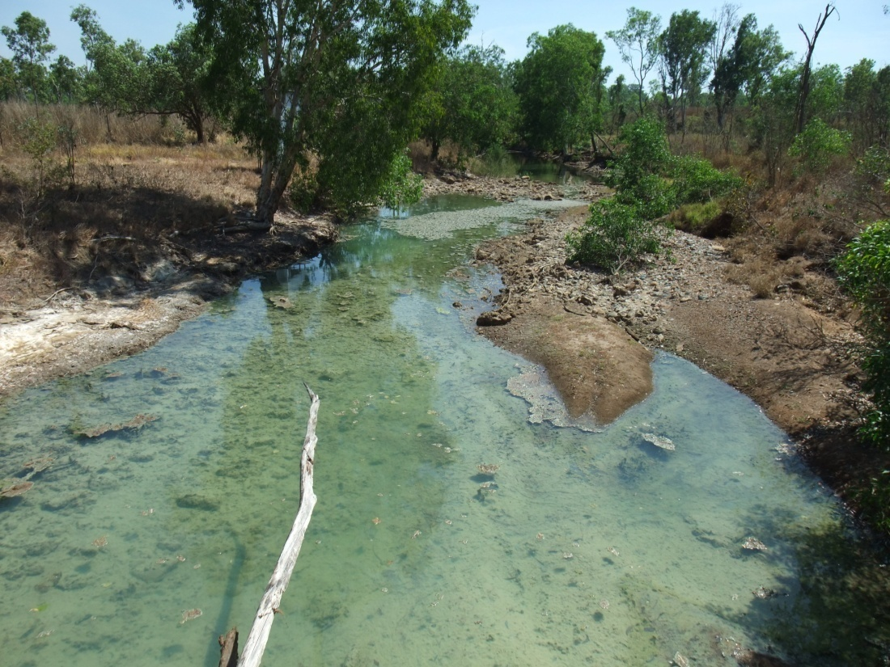
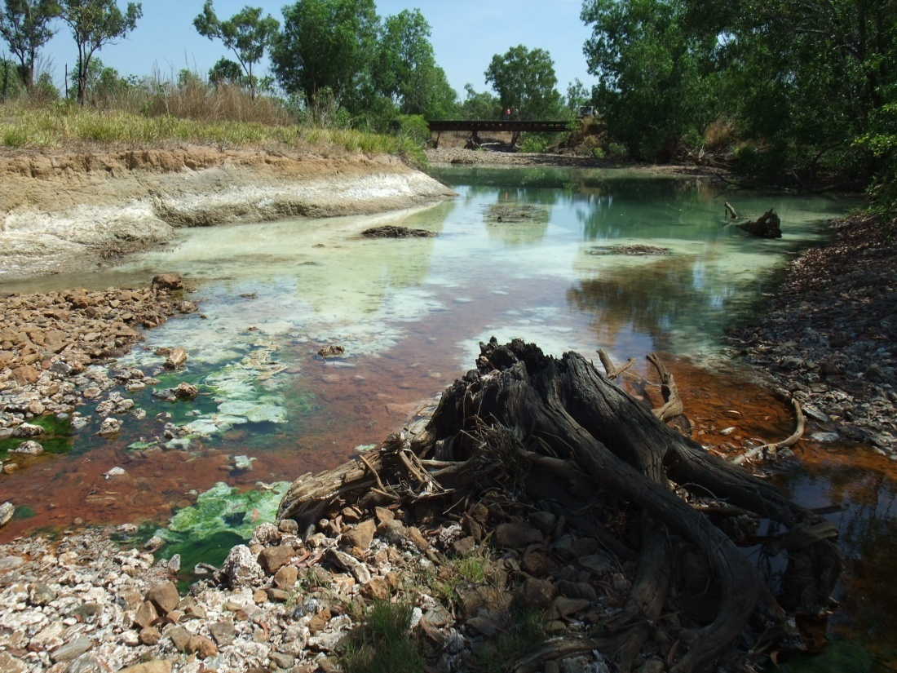
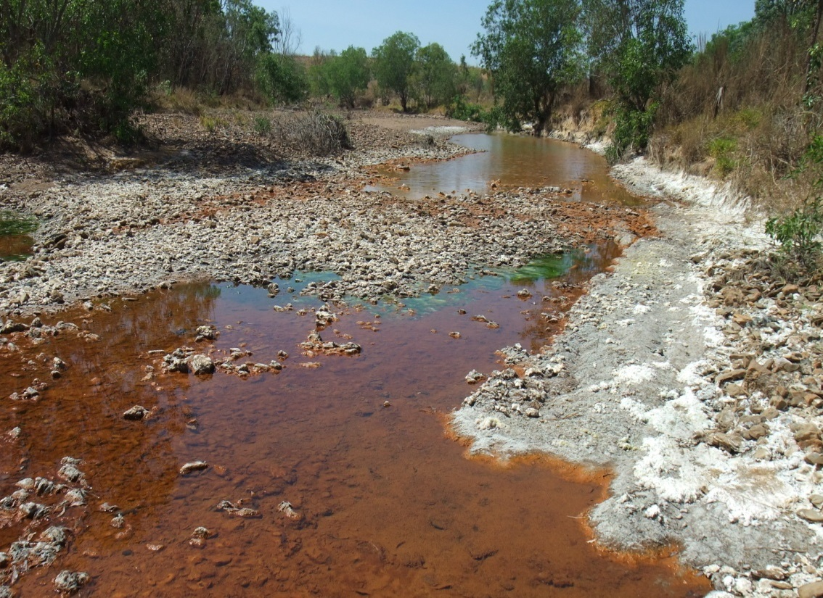
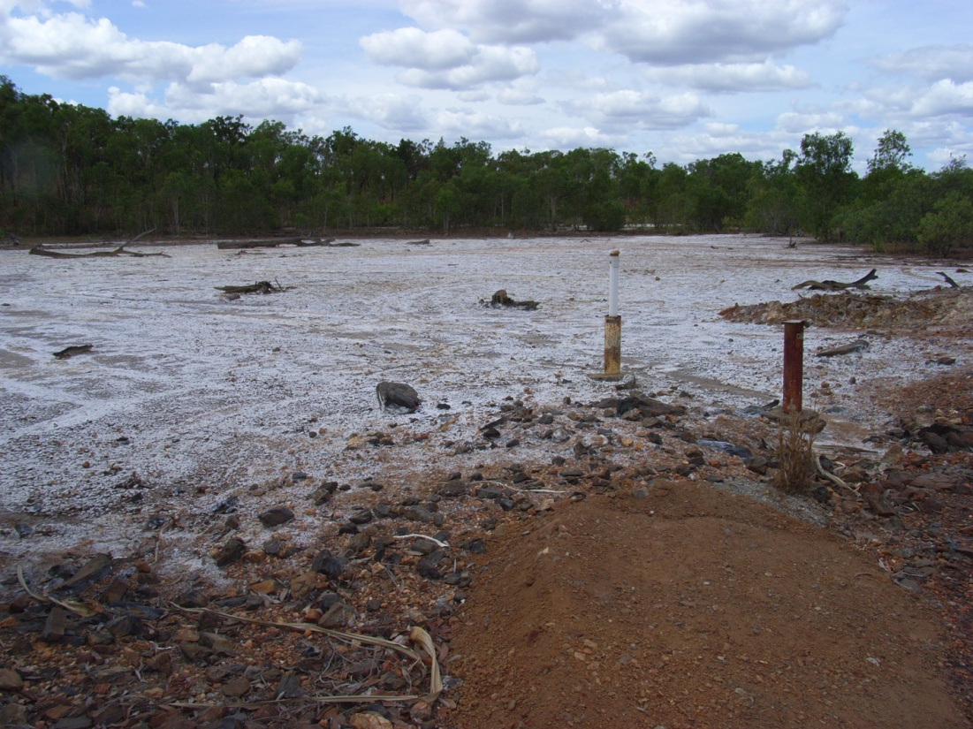
Rum Jungle U-Cu, NT

Slide 19
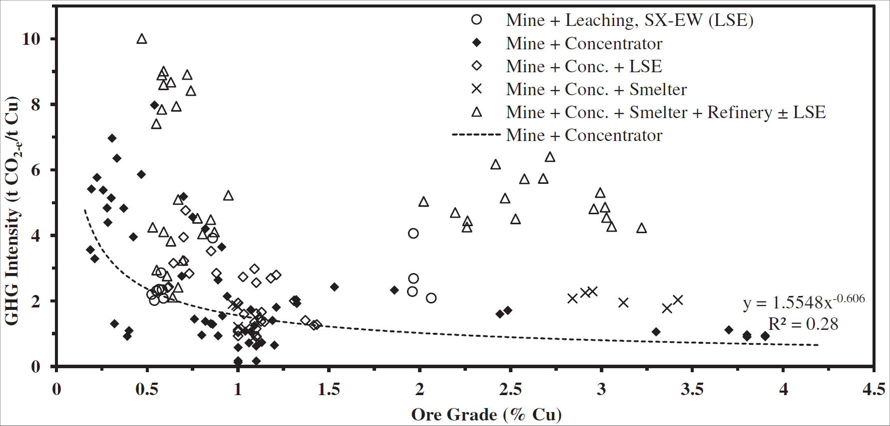
Sustainability Reporting: Cu
Many companies now report based on Global Reporting Initiative
Northey et al., 2013
Mudd: Sustainability Challenges v Modern Mining

Slide 20
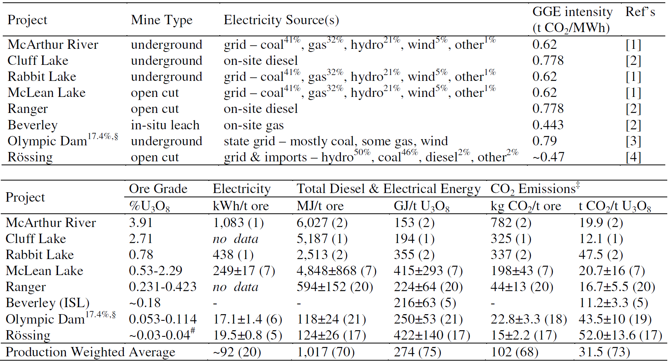
Sustainability Reporting: U
Mudd: Sustainability Challenges v Modern Mining

Slide 21
Sustainability Reporting: U
Mudd, 2014
Mudd: Sustainability Challenges v Modern Mining

Slide 22
New Technologies for Mining?
Mining is commonly risk averse to new technology – but given the fundamental mega-trends, mining needs to continue to invest in & adopt new technologies to address the myriad of complex issues
Many examples include:
  comprehensive environmental reporting – especially online systems;
  paste & thickened tailings – which reduce water risks & rehabilitation costs as well as much lower failure risks;
  better baseline studies – especially acid mine drainage risks;
  cumulative impact assessments – with other mines but also regionally;
  adoption of renewable energy – which is especially happening in Chile !;
  diversify production to include by-product & critical metals;
  adoption of pit backfill for high risk AMD projects;
  innovative process configurations to reduce energy-chemicals-water risks.
Mudd: Sustainability Challenges v Modern Mining

Slide 23
Summary: Mining vs Sustainable Development
Modern mining meets societal demands for a range of metals, minerals and energy resources – but it is getting harder and are
The fundamental issue is NOT resource depletion but the exponentially growing environmental (& social-economic) risks
  energy, carbon (CO₂), water, waste rock, tailings, rehabilitation, etc …
The industry needs to continually improve its approach, be more transparent & comprehensive in its reporting – especially in environmental monitoring
Critical need to adopt new technologies and approaches to mining which address these key sustainability challenges
Mudd: Sustainability Challenges v Modern Mining

Slide 24
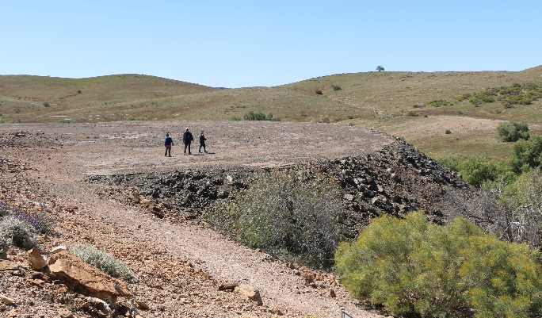
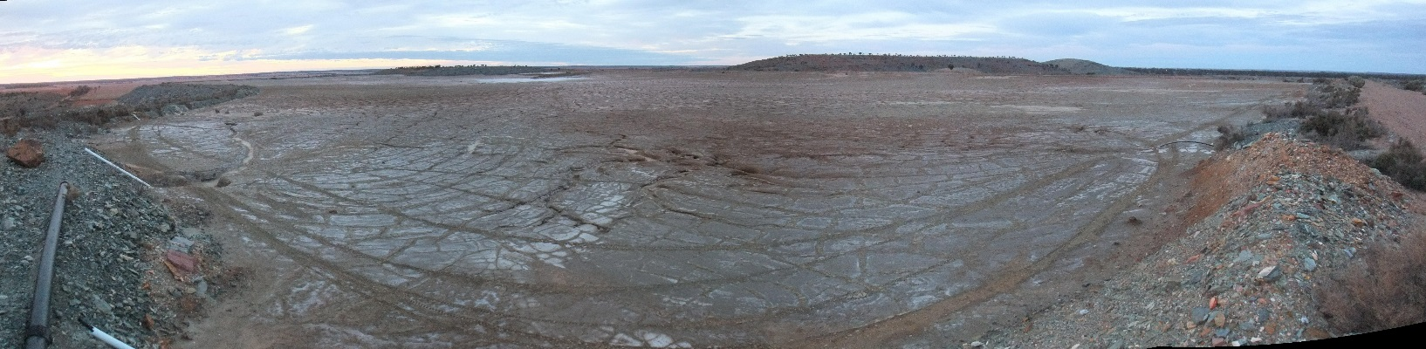
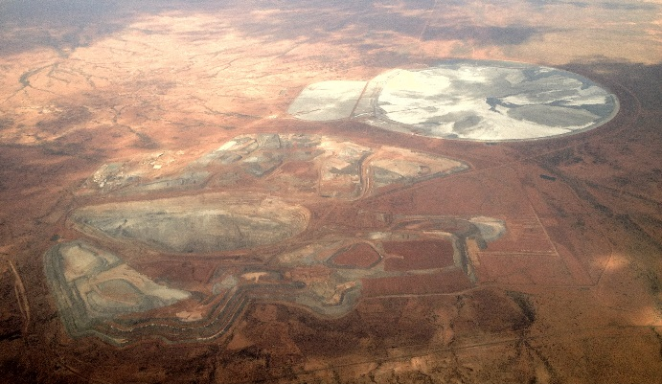
Acknowledgements
Australia’s CSIRO Mineral Resources Flagship
PhD students Zhehan Weng, Stephen Northey & Tim Werner
Many mining communities across the world
Prof. Tom Graedel (Yale), Prof. Upmanu Lall (Columbia) & many other academic colleagues
Email me if interested in the numerous papers !!

